Slide 1
Employee Features & User Guide
Document Version: v2.0

Slide 2
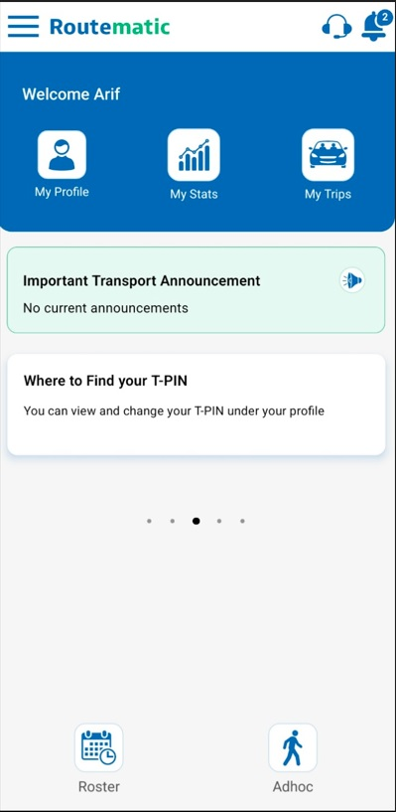
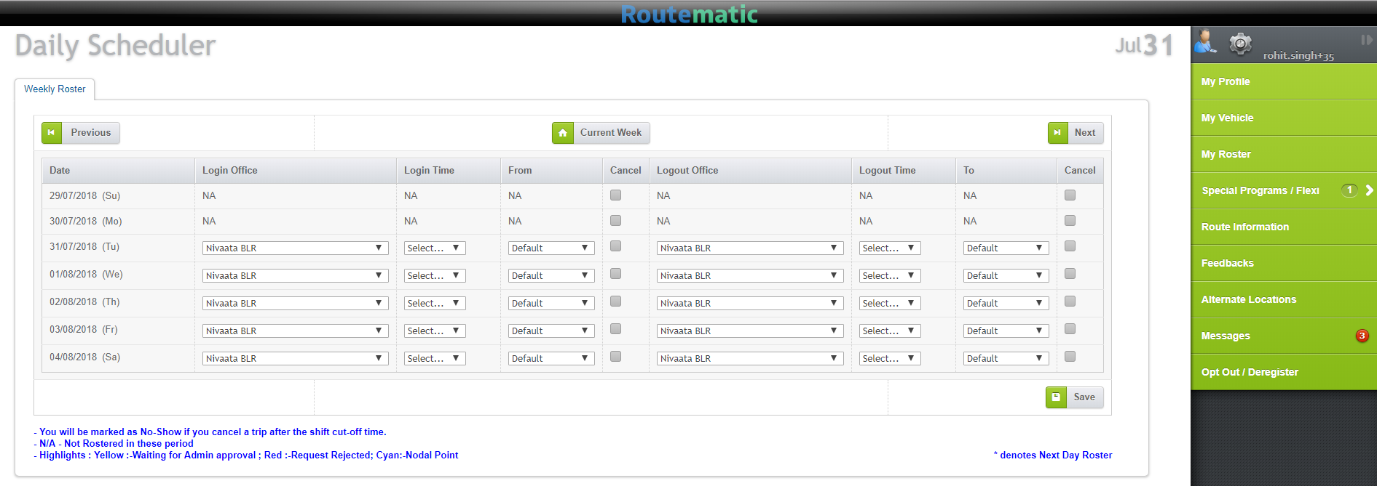

How Can I Access My Transport Information?
Multiple information channels to address your transport related queries :
By Logging In to the Routematic Web Portal : https://mercer.routematic.com/
By Routematic Mobile Application
By Calling the Routematic IVR
NCR | 011 61194653
Mumbai | 022 45075198
Pune | 020 67326578
Routematic – Employee Web Console
Routematic – Employee IVR
Routematic – Employee Mobile App

Slide 3

SECTION I
MOBILE APPLICATION

Slide 4
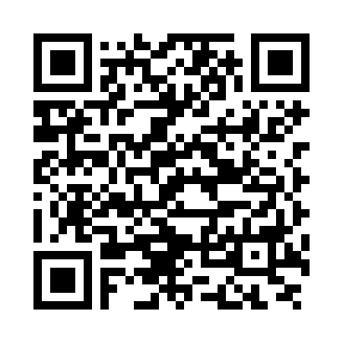

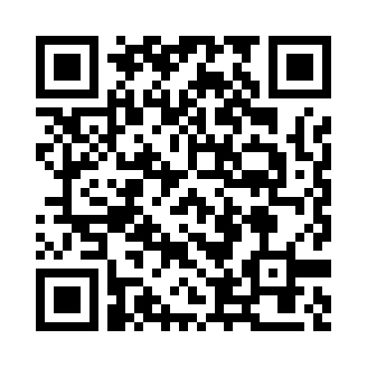

How To Install Routematic Mobile APP?
Download Routematic app from:
Google Play Store
Apple App Store

Slide 5
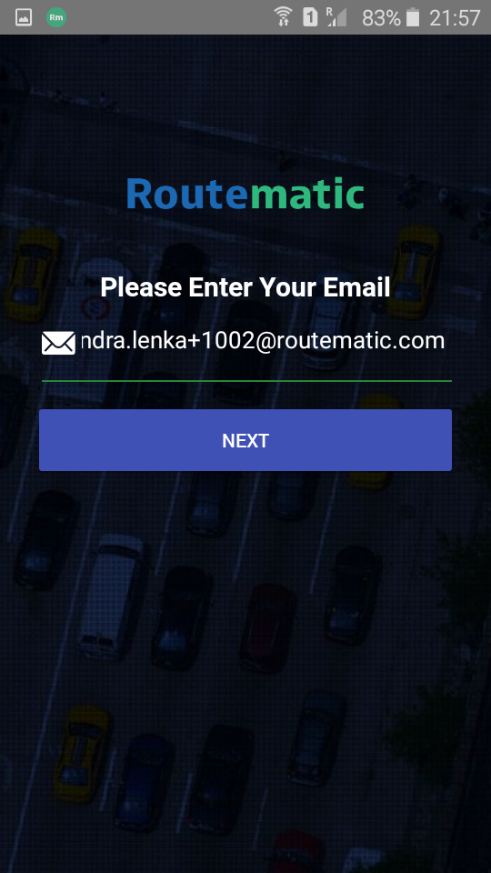
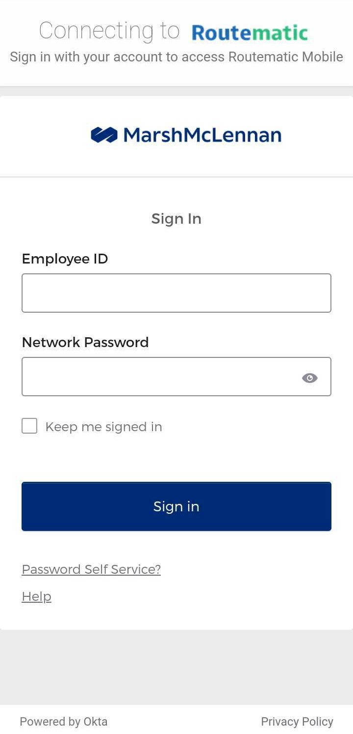
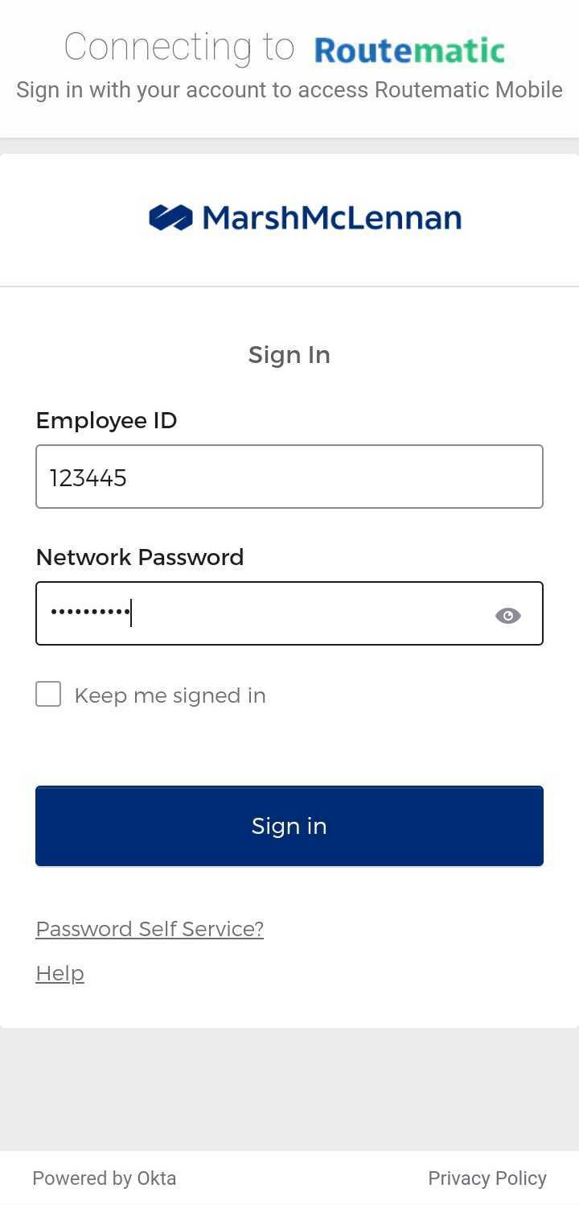
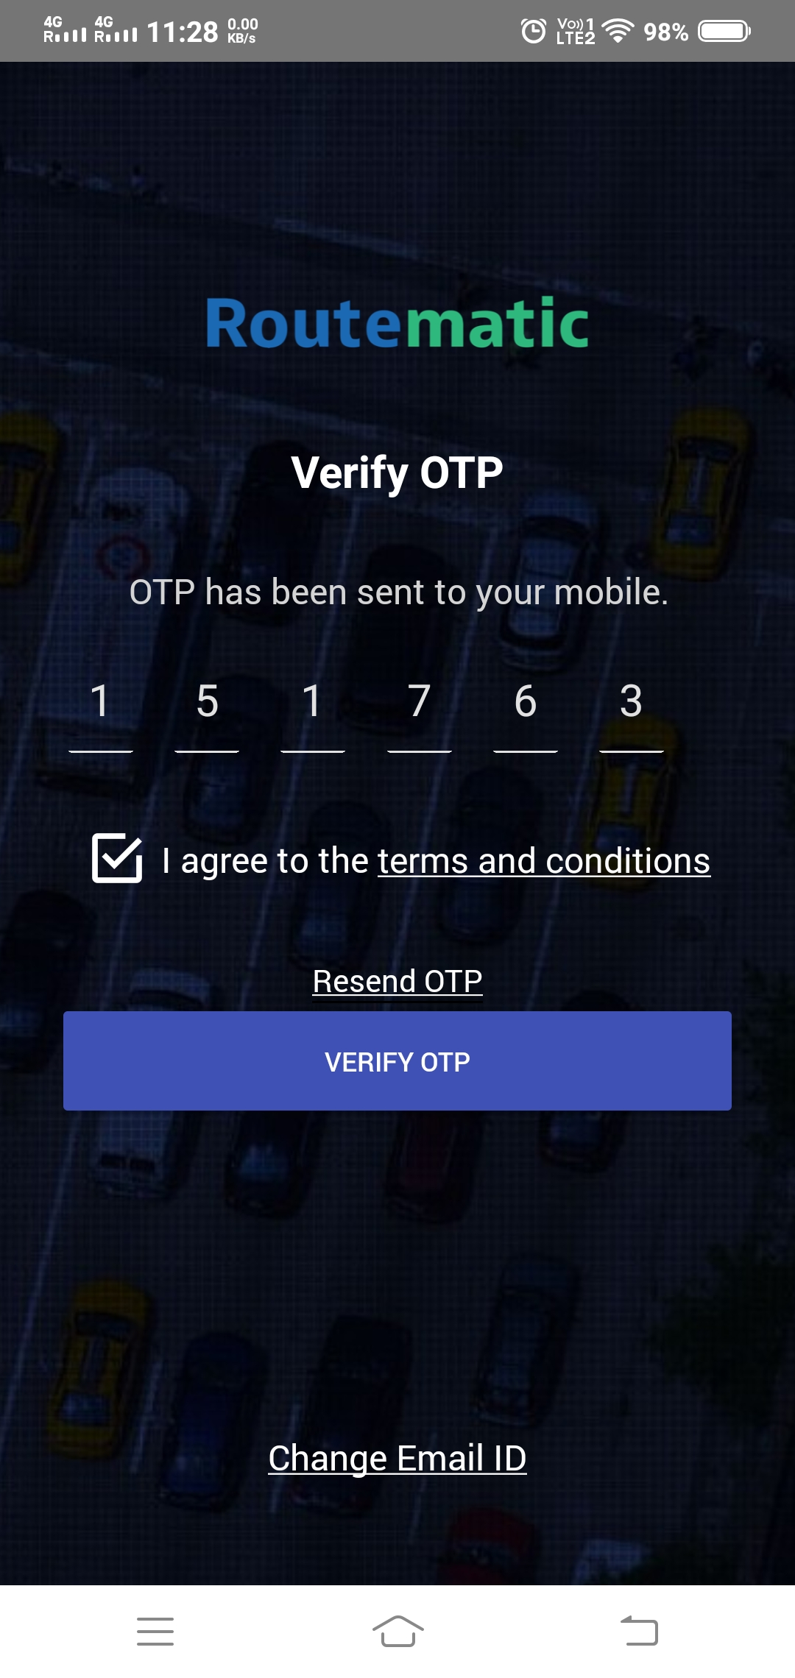
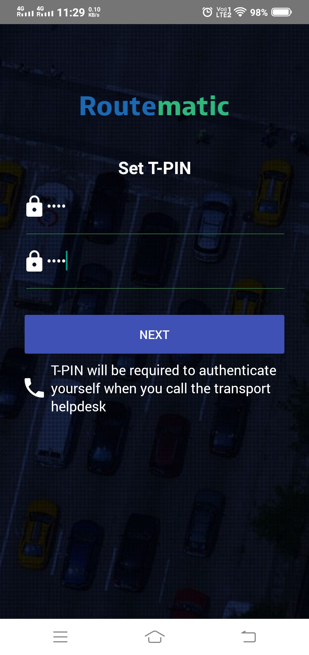
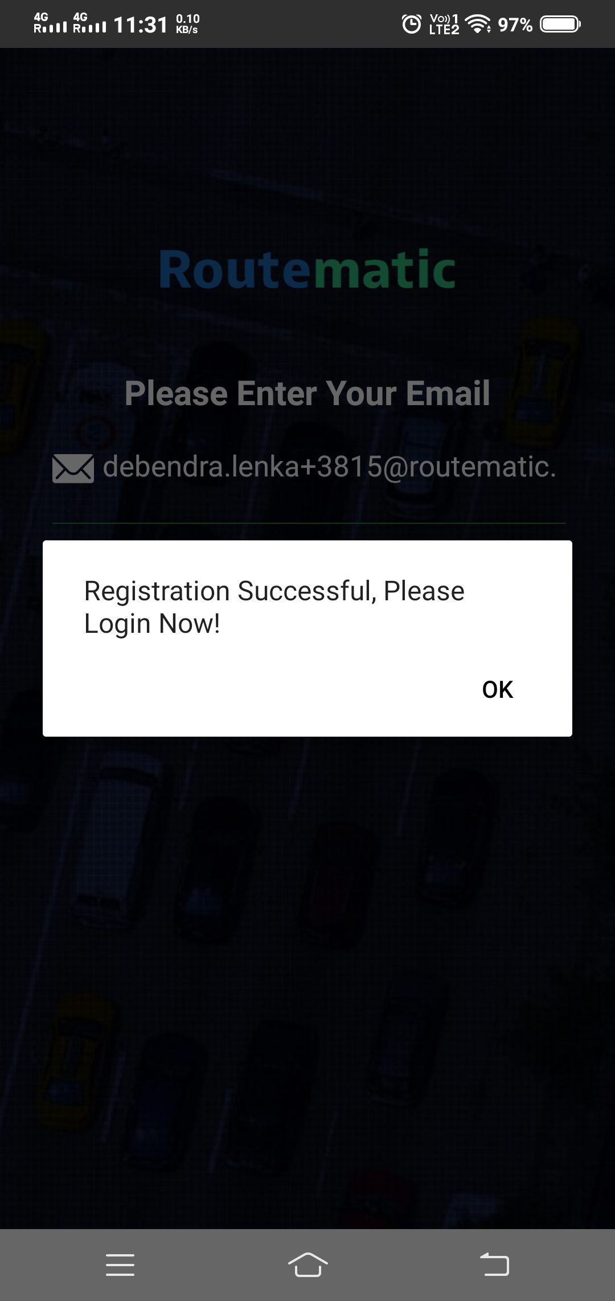
How to Register Via Routematic Mobile Application?
How do I Register:
Open the App and enter your official Email ID
Sign-in on your official account and you will be directed to your OKTA/SSO Login page
OTP will be received on your official Email ID and on your registered mobile no.
Enter OTP & check off the Terms and Condition and click on “Verify OTP”
Set a 4-digit T-Pin (T-Pin is a 4-digit pin of your choice to mark your safe drop / Interact with IVR) and click on “Next”
Update details of your profile, click on next to complete the registration process.
Note: You need to register only one time either through Routematic Web Portal or your Mobile App

Slide 6









How To Use Routematic Employee App?
“My Profile” option will enable user to view as well as make changes to their profile
“Notification Icon” will keep you updated on all alerts like Cab allocation, Travel alerts, Bus Pass, Seat allocations, etc.
“My Stats” show data pertaining to Shift and Adhoc
Announcements feature on the app home screen will allow your Transport Team to keep you updated about upcoming transport related events, etc.
Useful tips and tricks that you should know regarding the app usage, transport policies and best practices
Reach out to your Transport Admin directly from your mobile app by tapping this option
View your upcoming trips
Select and save your Roster directly from the app
Tap to place Ad-hoc cab requests from the app

Slide 7
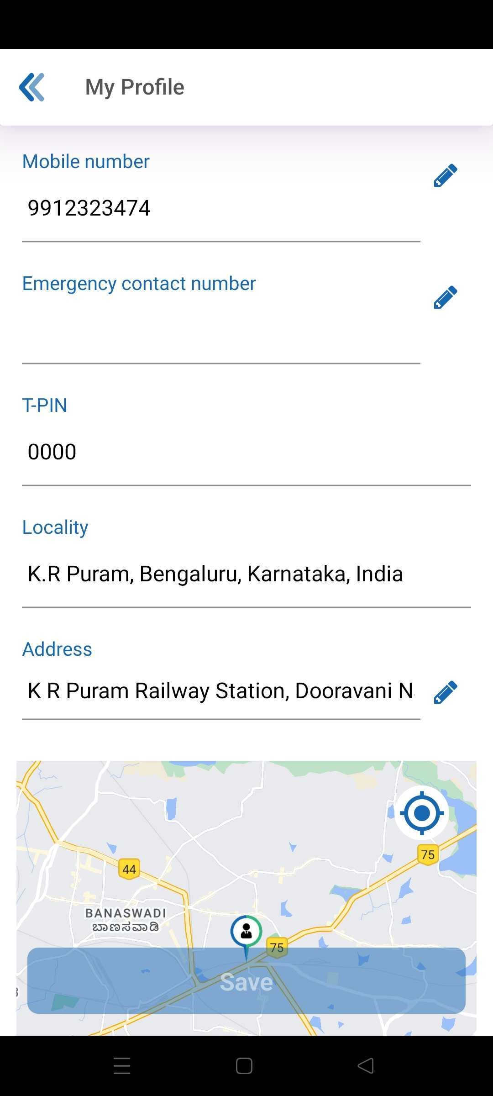
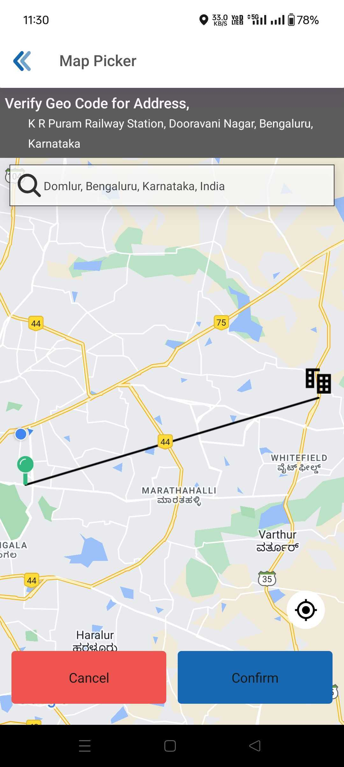
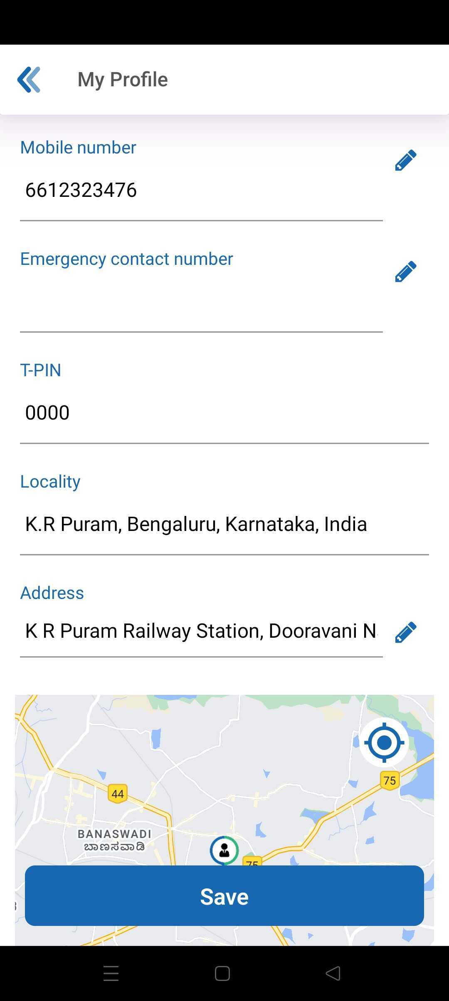
Employee Profile Update Option
My Profile allows you to view and edit the following fields in from your profile
Mobile Number | Emergency Contact Number
T-pin | Locality
Address | Pickup/Drop Point

Slide 8
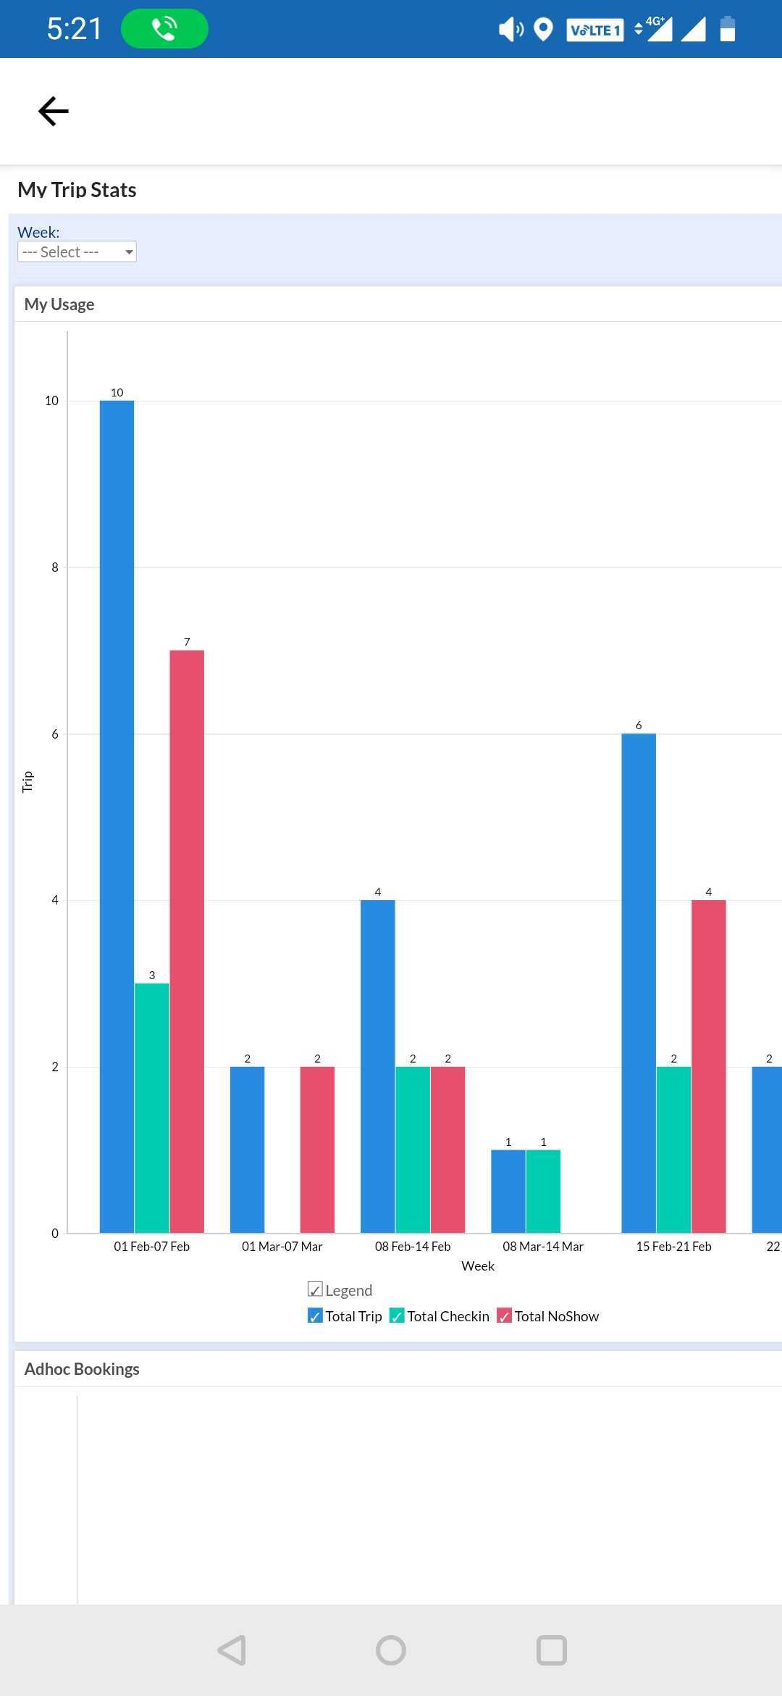
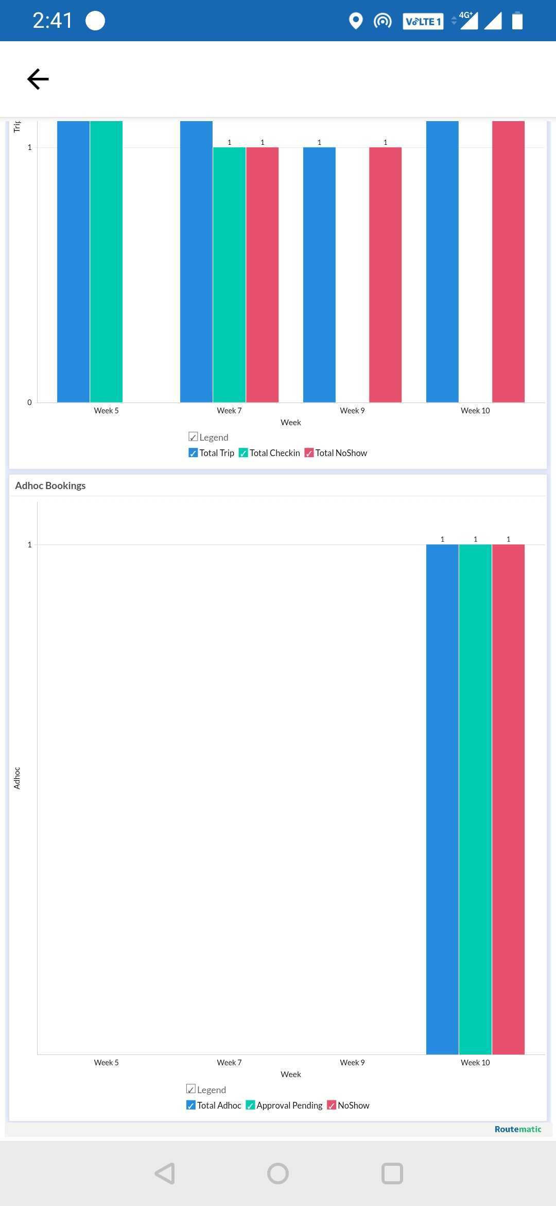
My Stats
My stats has two sections Shift and Adhoc, which will show the last 5-week data. User can select a week from week dropdown box.
In shift, it will display total trip, number of No-show & number of checked-in trips.
In Adhoc, it will display total Adhoc, number of request pending approval & number of No-show.

Slide 9
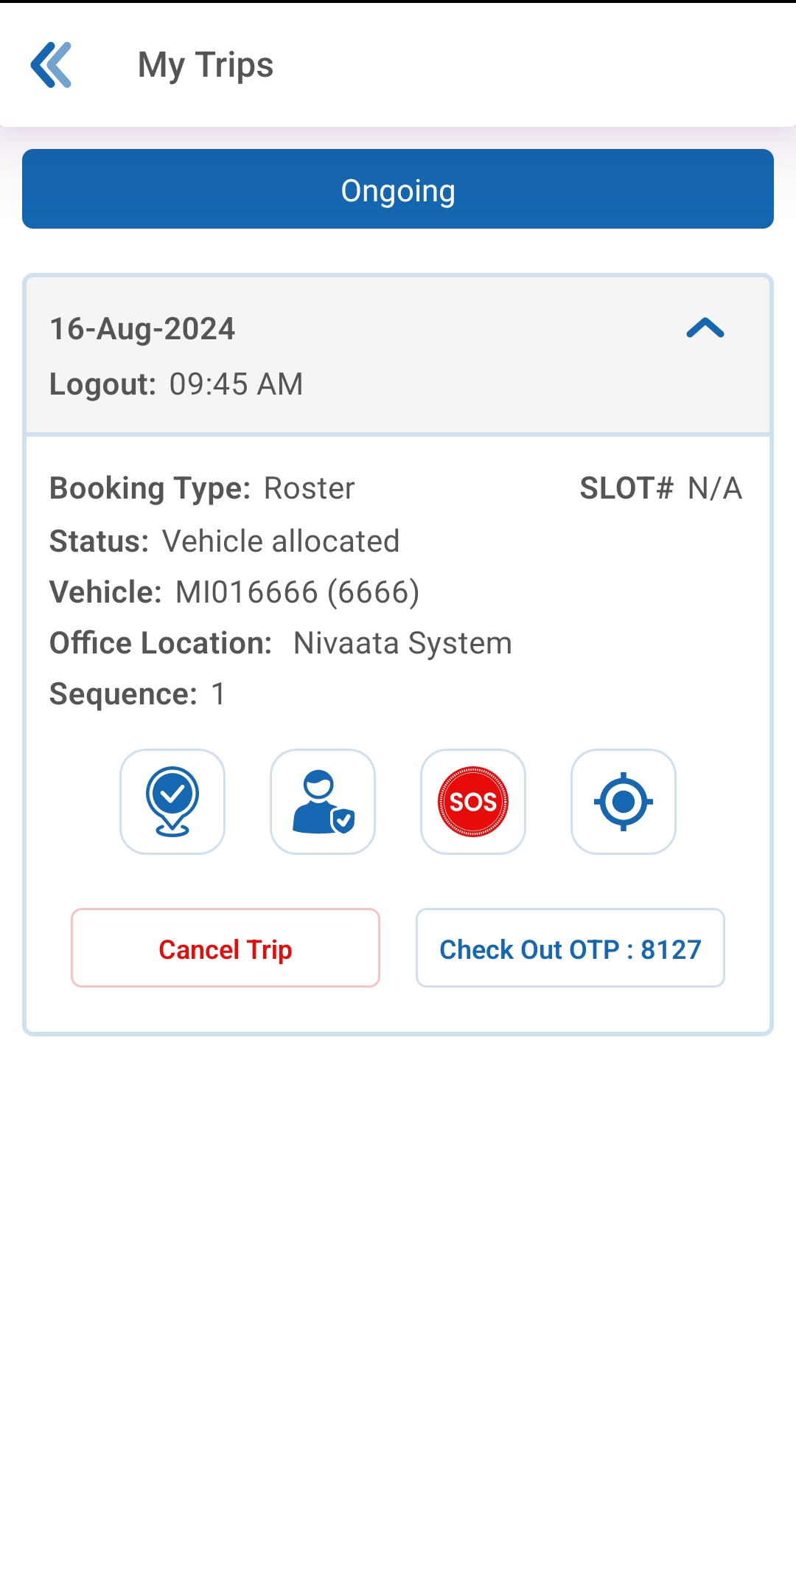
How to view My upcoming Trips in Mobile App
1
2
My Trips allows you to view your 3 upcoming trips.
It displays the current status of your request.
It also displays the details such as your ETA, Vehicle Number, Sequence, Slot number, and OTP once the trip is deployed/approved by admin.
Additional Options
To mark Check-in/Checkout (If enabled)
Safe Drop
Raise SOS
Track Vehicle
Tap CANCEL TRIP for quick cancellation of the upcoming trip without going to the roster screen.

Slide 10
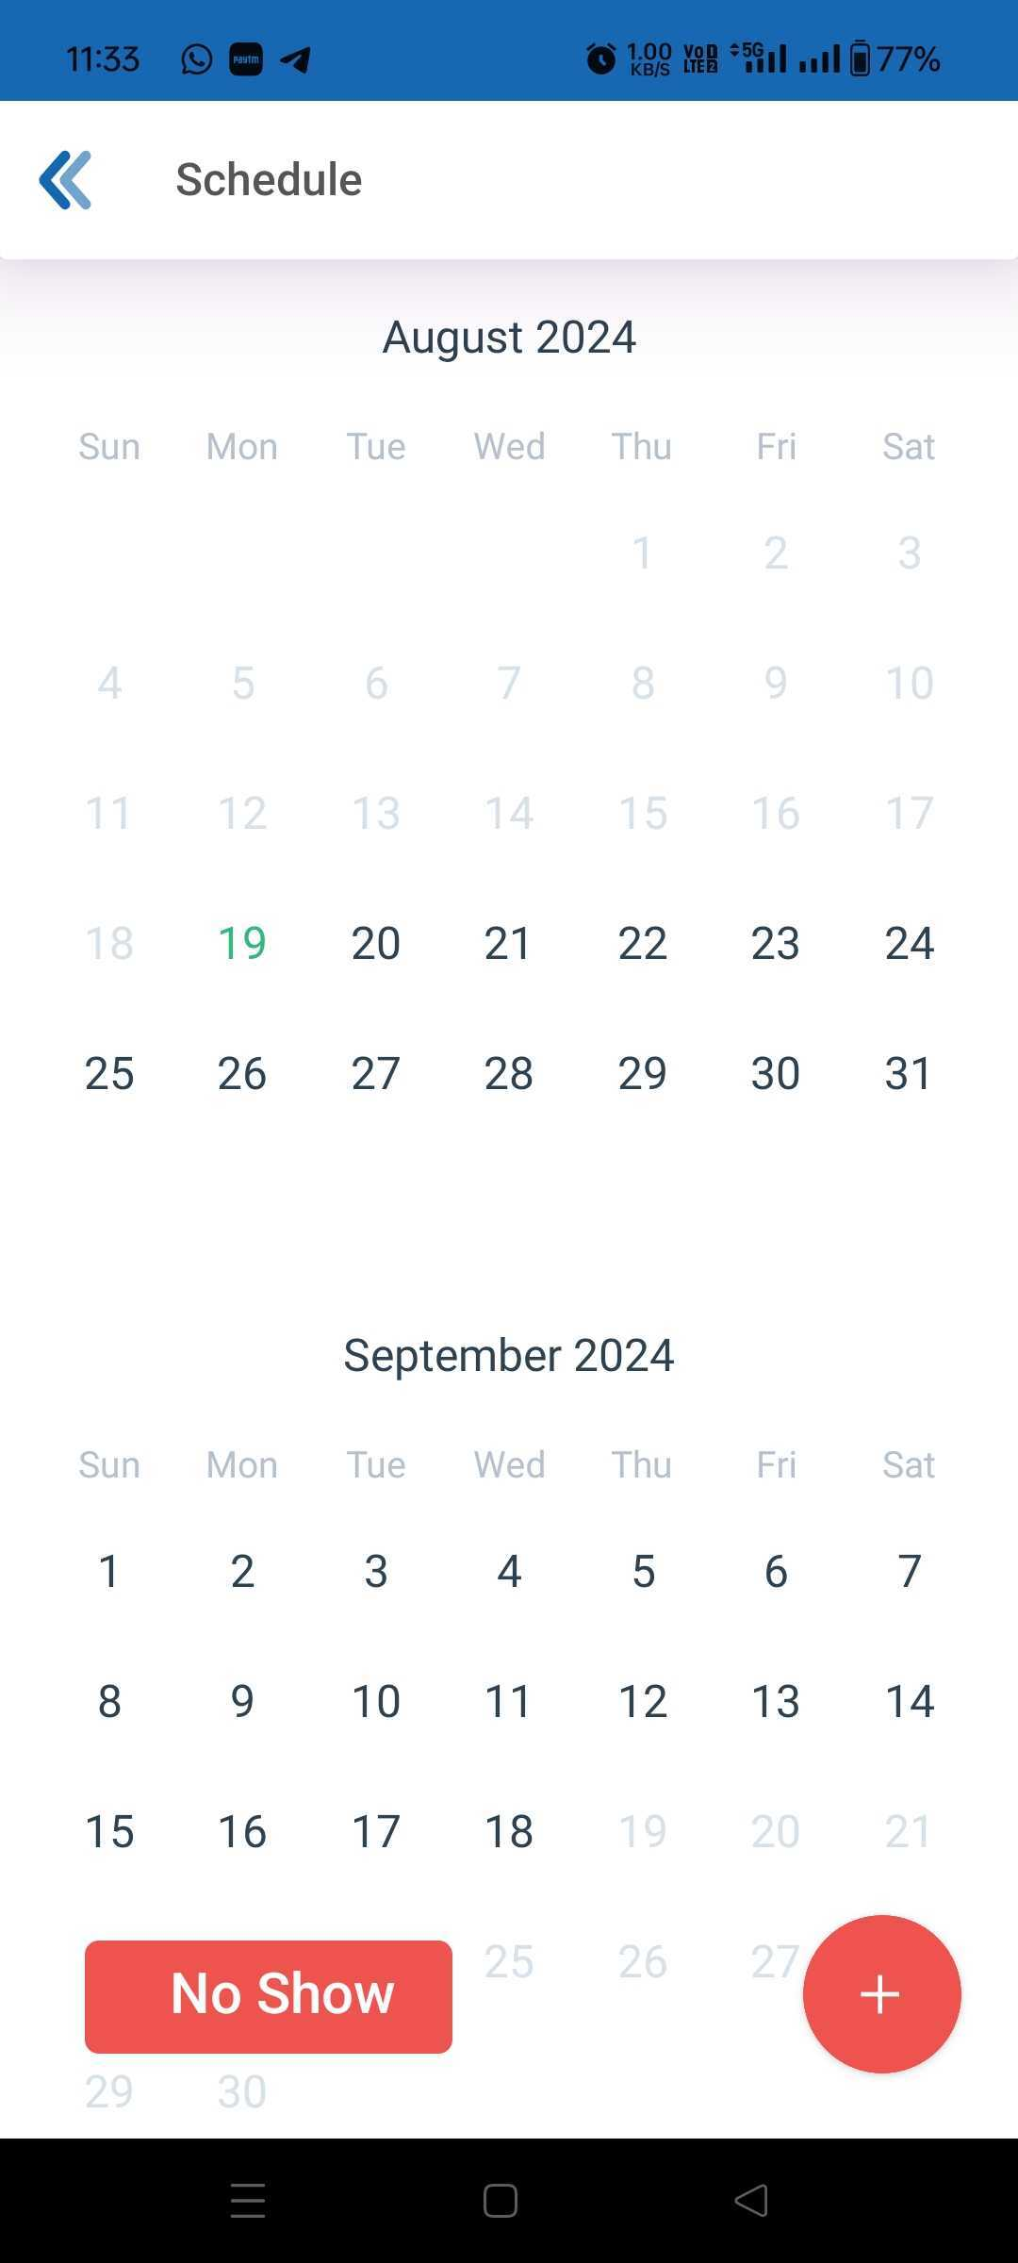
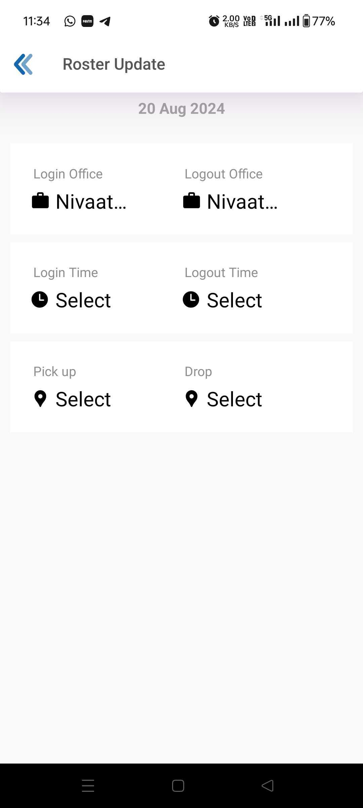
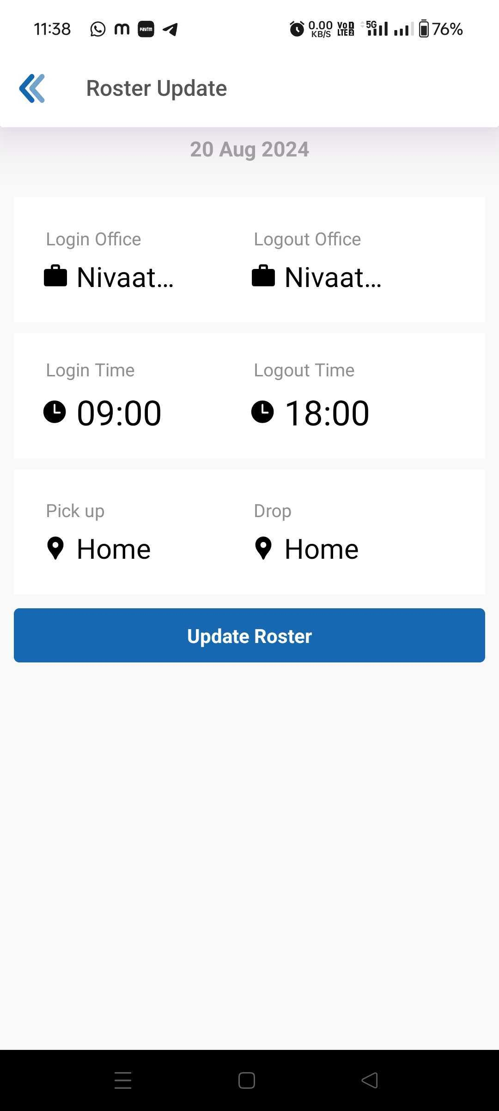
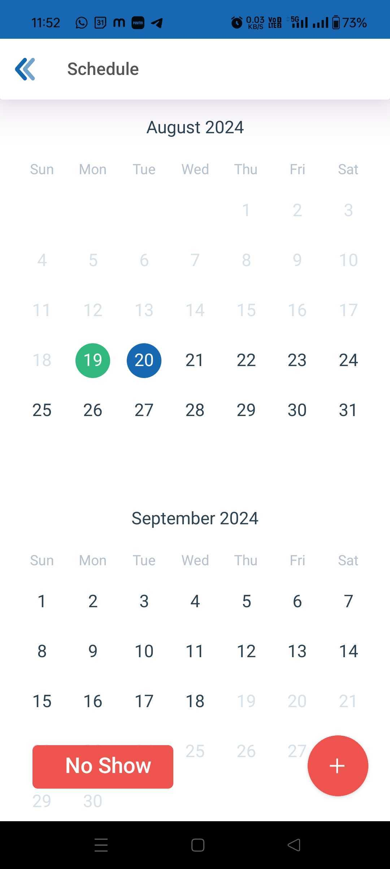
Cab Booking – Roster (Single Day)
Click on the Roster Icon, Roster page will open with dates.
Date in Green indicates current date.
Single Day Rostering
Select Single Day 20th Aug
Select Login and Logout Time Select Your Pickup and Drop Location
Post Selection of Login & Logout Time and Pickup & Drop Point Click on Save/Update Roster
Once the roster is saved, the date will have a Blue background. Date with green background indicates that the roster is available for the current date.

Slide 11
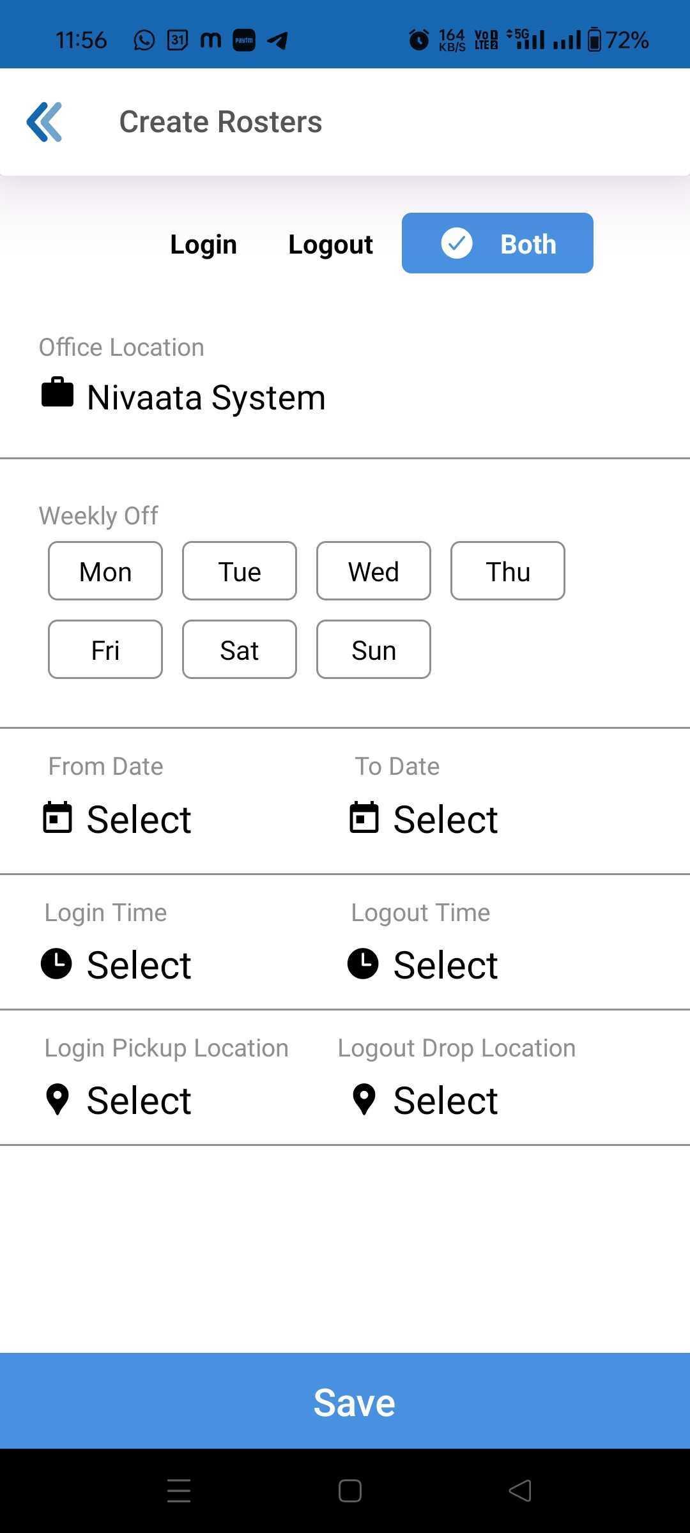
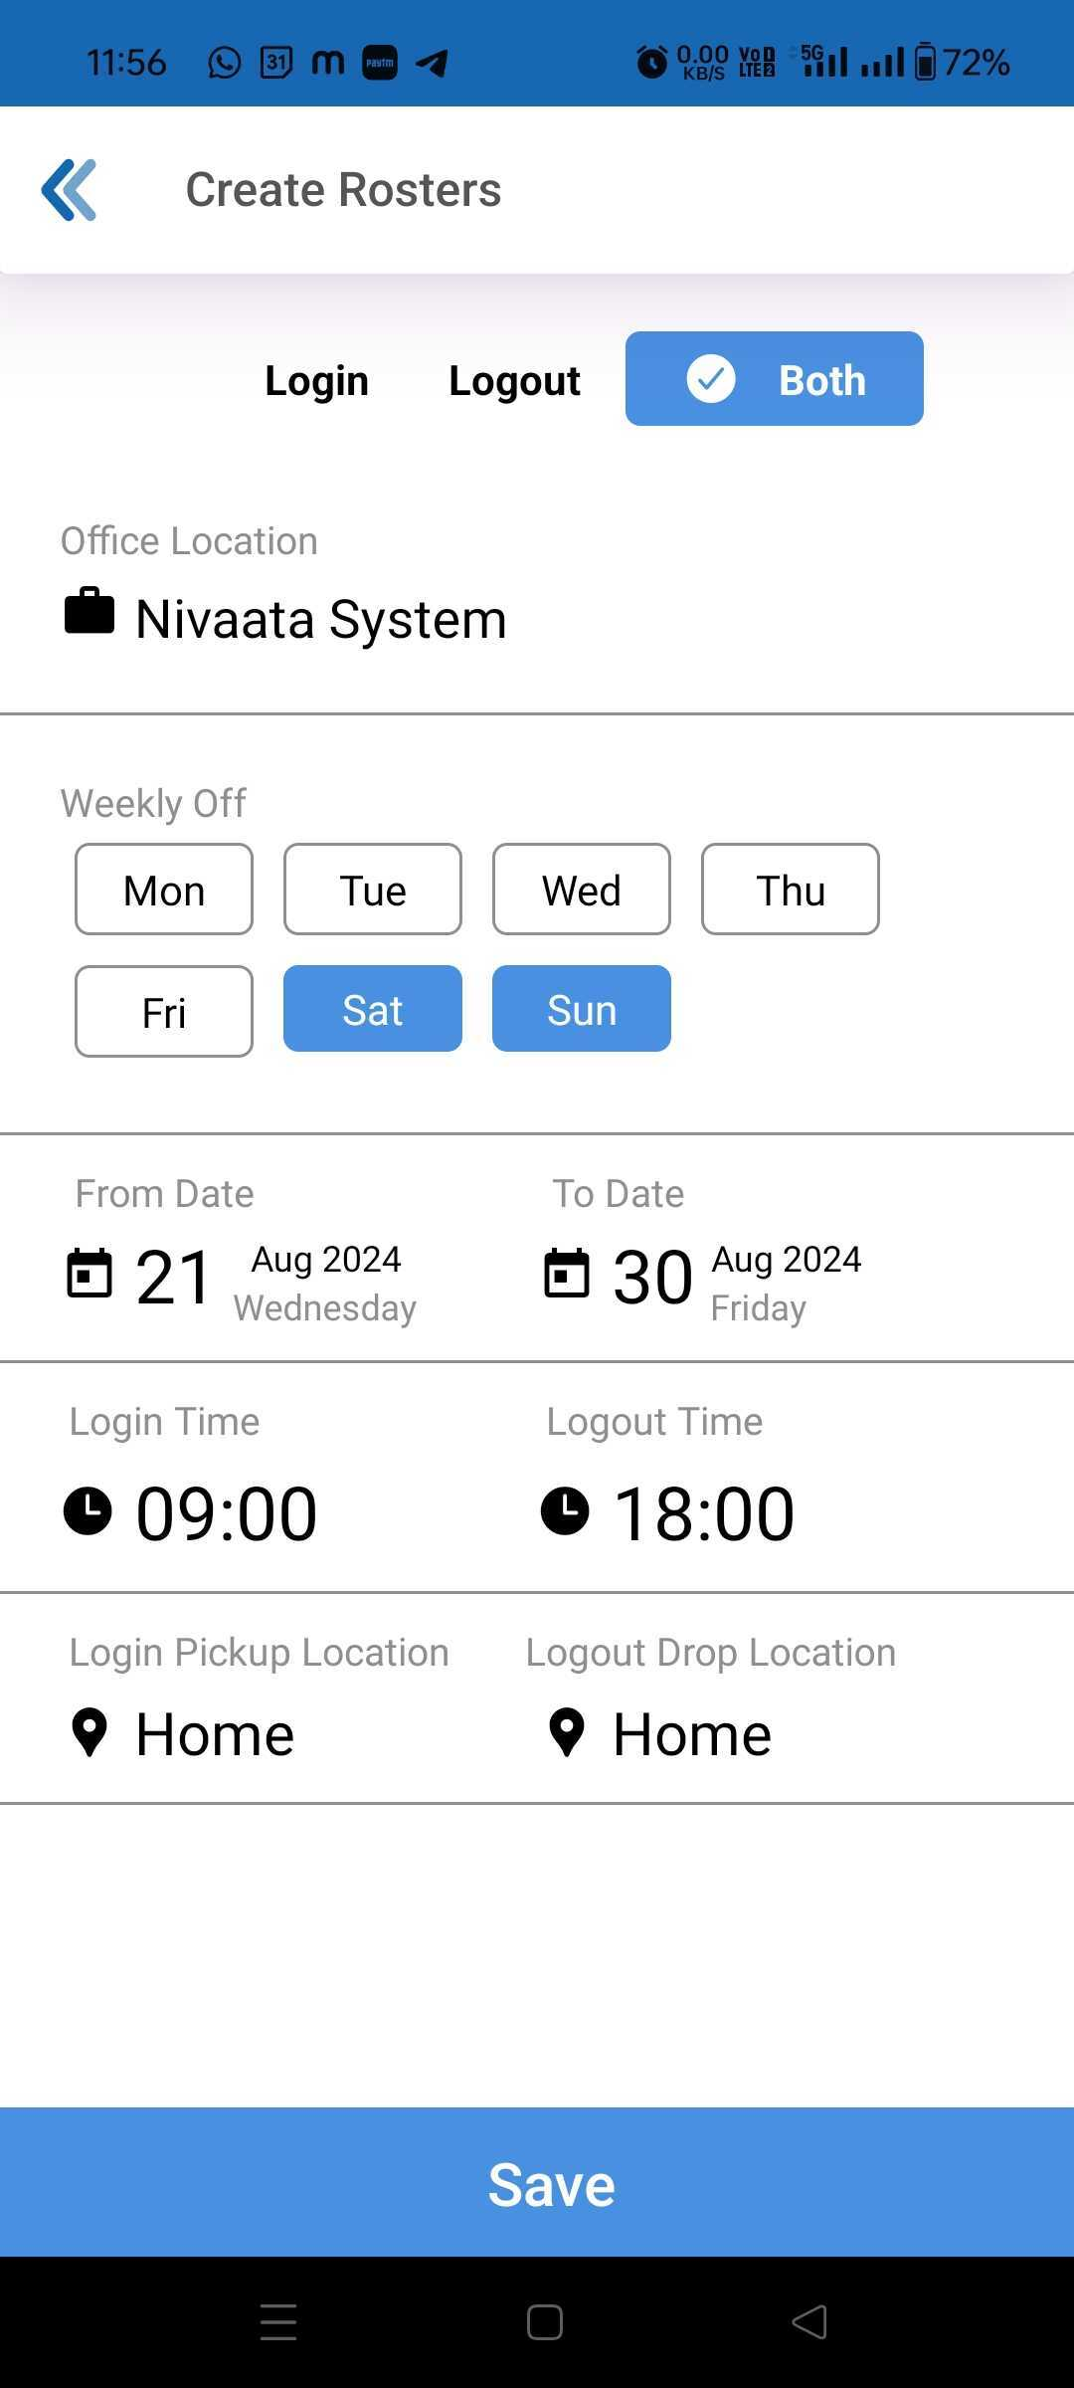
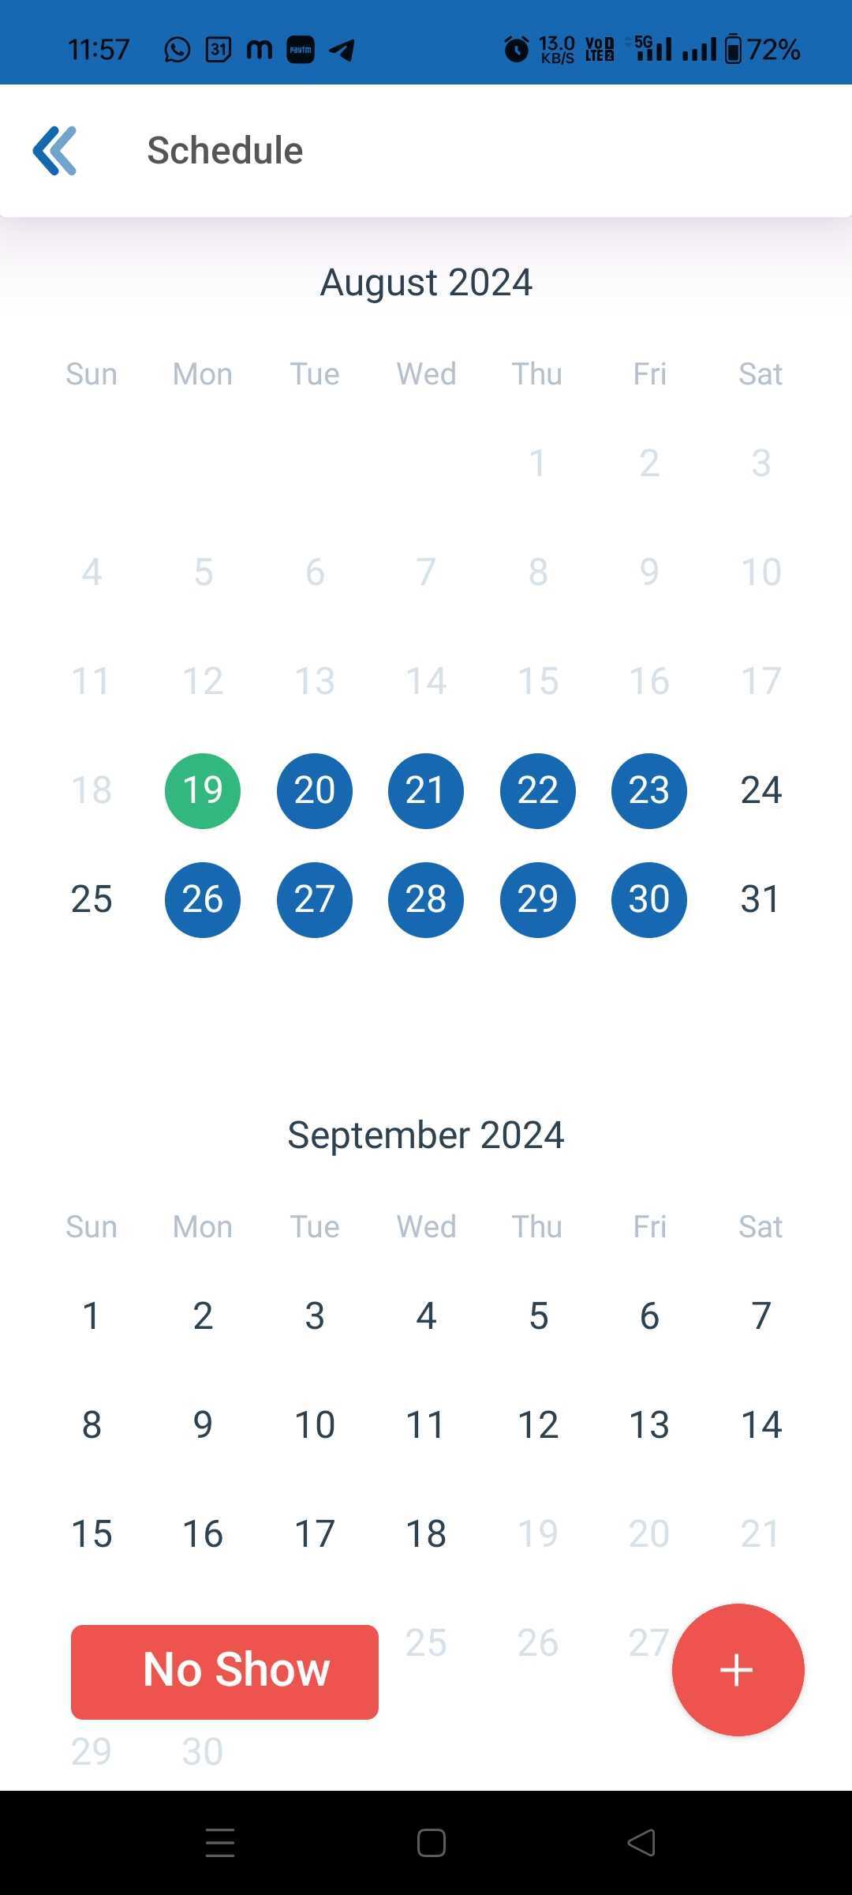
Cab Booking – Roster (Date Range)
Click on the “+” icon to do rostering for a range
Select the Roster for Login, Logout or Both
Select your weekly off days
Select the From and To date for Rostering
Select your login and logout time
Select you Pickup and drop Location
Click Save
Once the roster is updated, the future date for which the roster is updated will have blue background

Slide 12
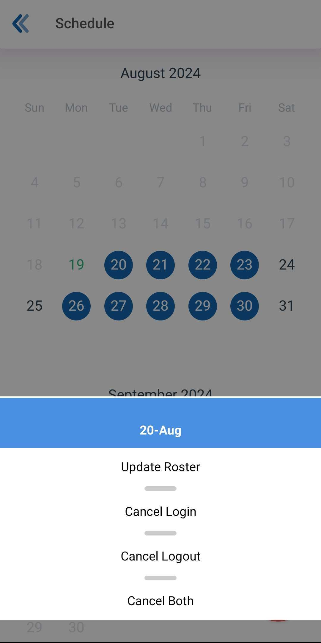
Cab Booking – Quick Action
Quick Action allows you to make changes in the existing roster with ease.
Select any date for which you want to make changes and select what change you want to do:
Update Roster – For Shift time change
Cancel Login – Allows you to only cancel for login
Cancel Logout – Allows you to only cancel for logout
Cancel Both – Select the option if you want to cancel both Login and Logout roster
Quick action will only be available for the Date where the user have Login roster or Logout roster or both.

Slide 13
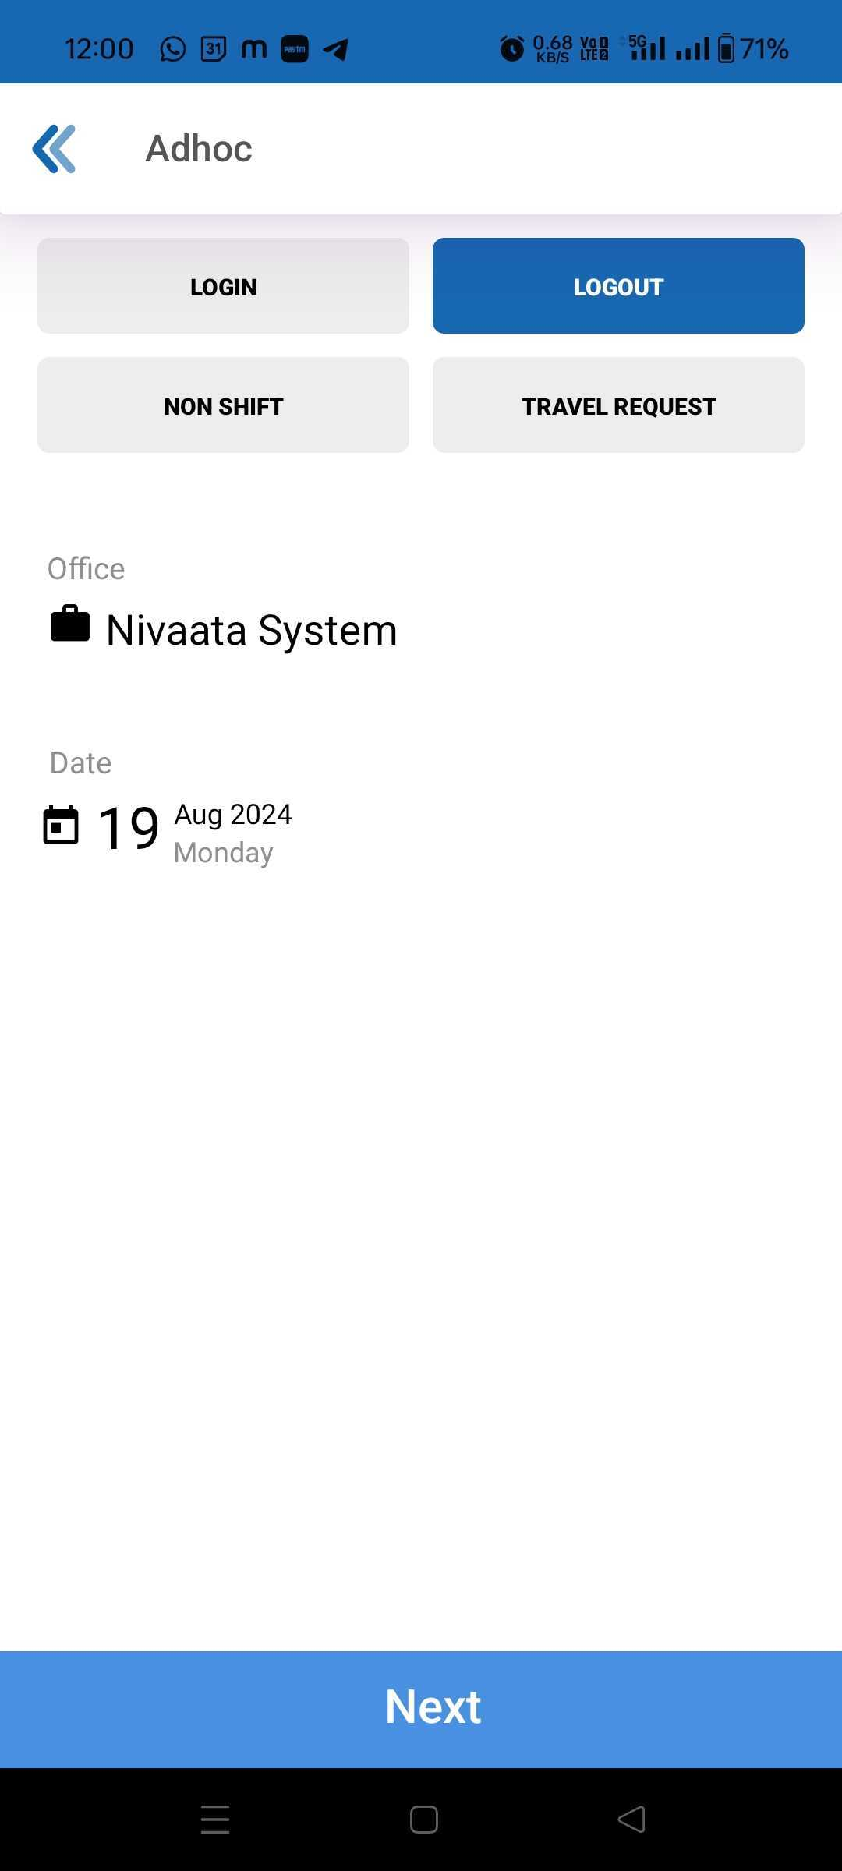
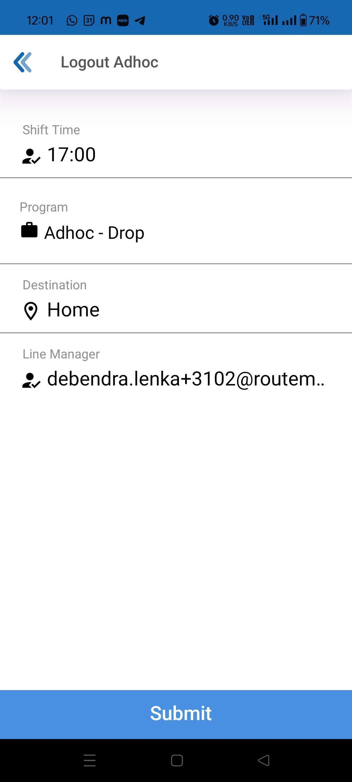
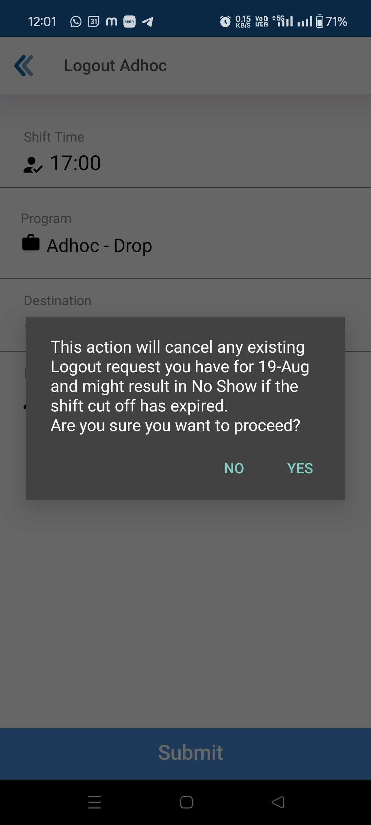
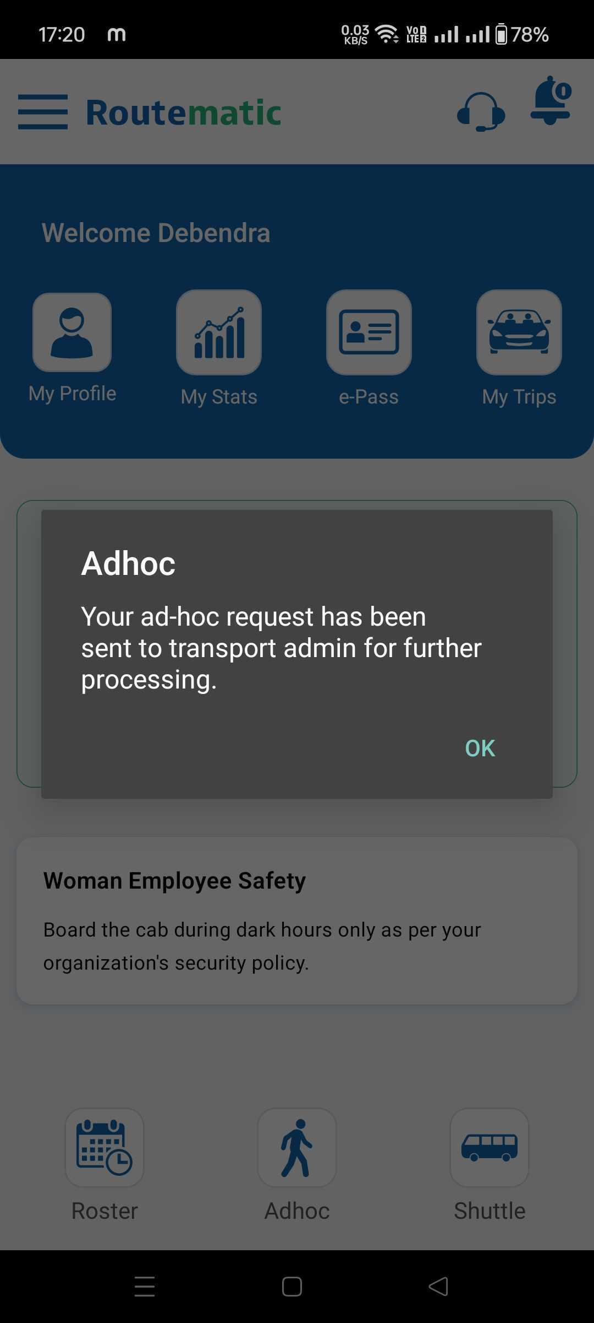
Cab Booking – Adhoc
Use The Adhoc Option To Raise Last Minute Cab Request!
Click on “Adhoc” Icon to raise an Adhoc request
Select your Adhoc Type – Login/Logout/Non-Shift
Select your Shift Time and Program type (if multiple) and click on submit
Confirm by selecting Yes/No
Notification confirmation of request being raised

Slide 14
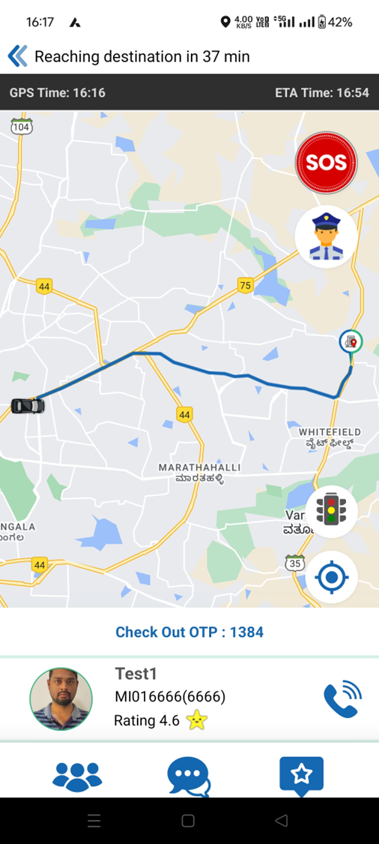


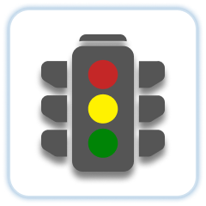



Track Vehicle
Raise a panic alarm while on an active trip
View Security Guard Details
Real-time traffic updates at a glance
View co-passengers
Call driver from the tracking screen
Chat with your fellow passengers
Raise feedback

Slide 15
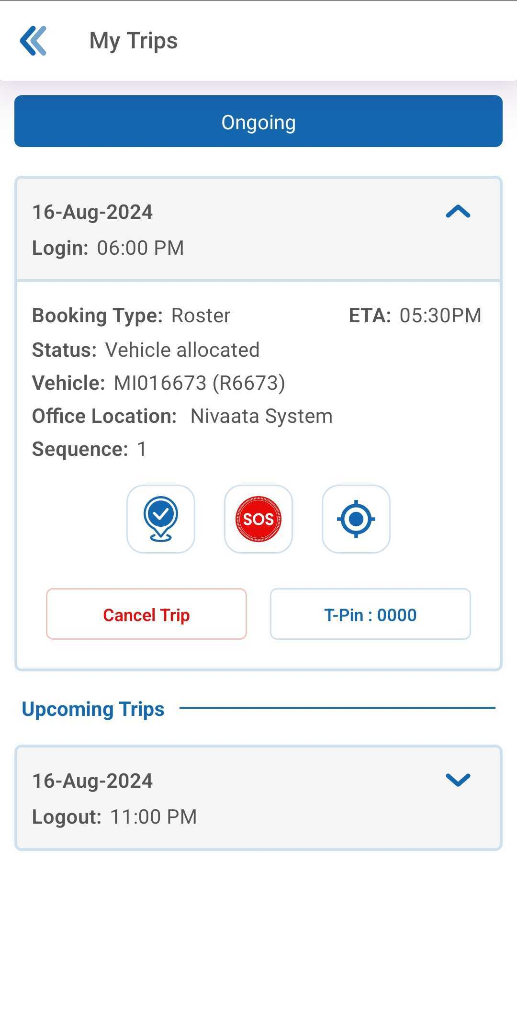
How Do I Raise SOS/PANIC
SOS button will be available on My Tips and Tracking Page
If you find yourself in an emergency, tap the SOS button and swipe right. This will instantly set off an alarm in the transport room and provide your transport team with the location of your cab and all other details necessary to respond to the SOS.
Click on the SOS button and swipe right to raise the SOS
SOS to be only used in case of an Emergency

Slide 16
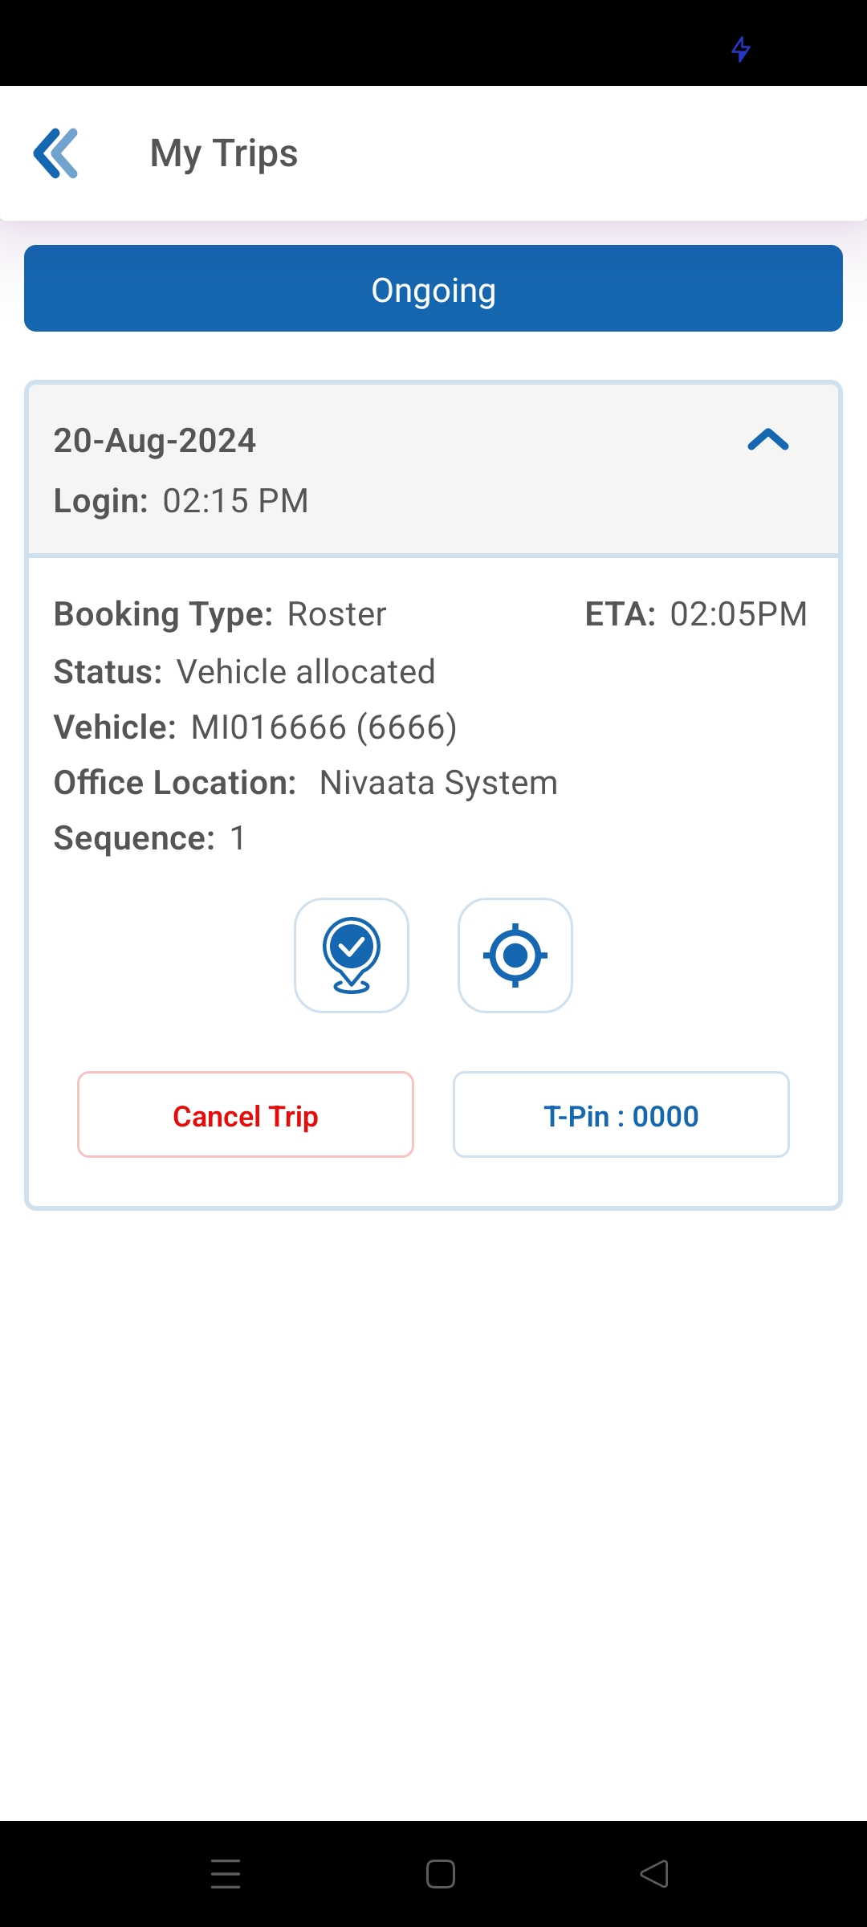
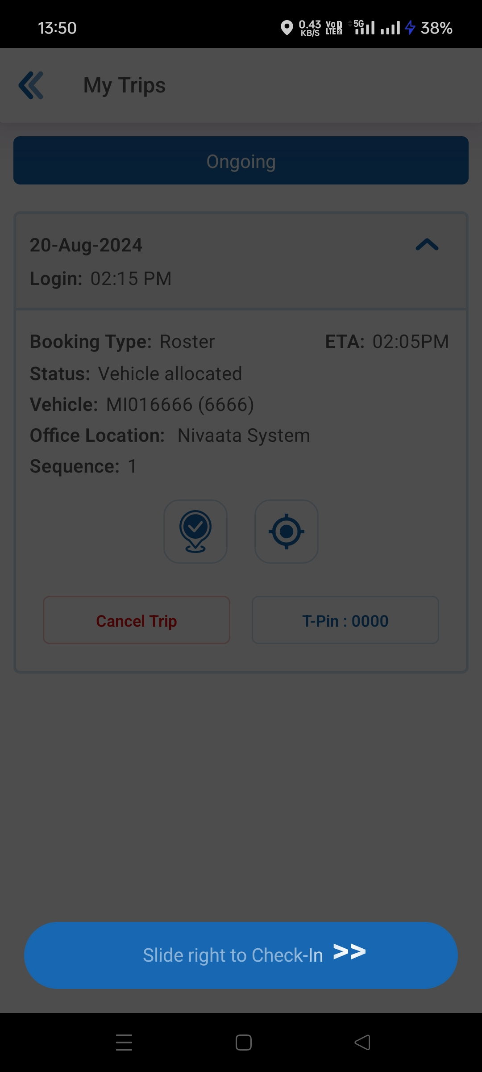
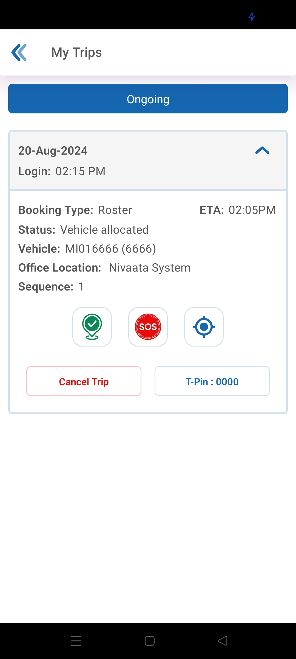
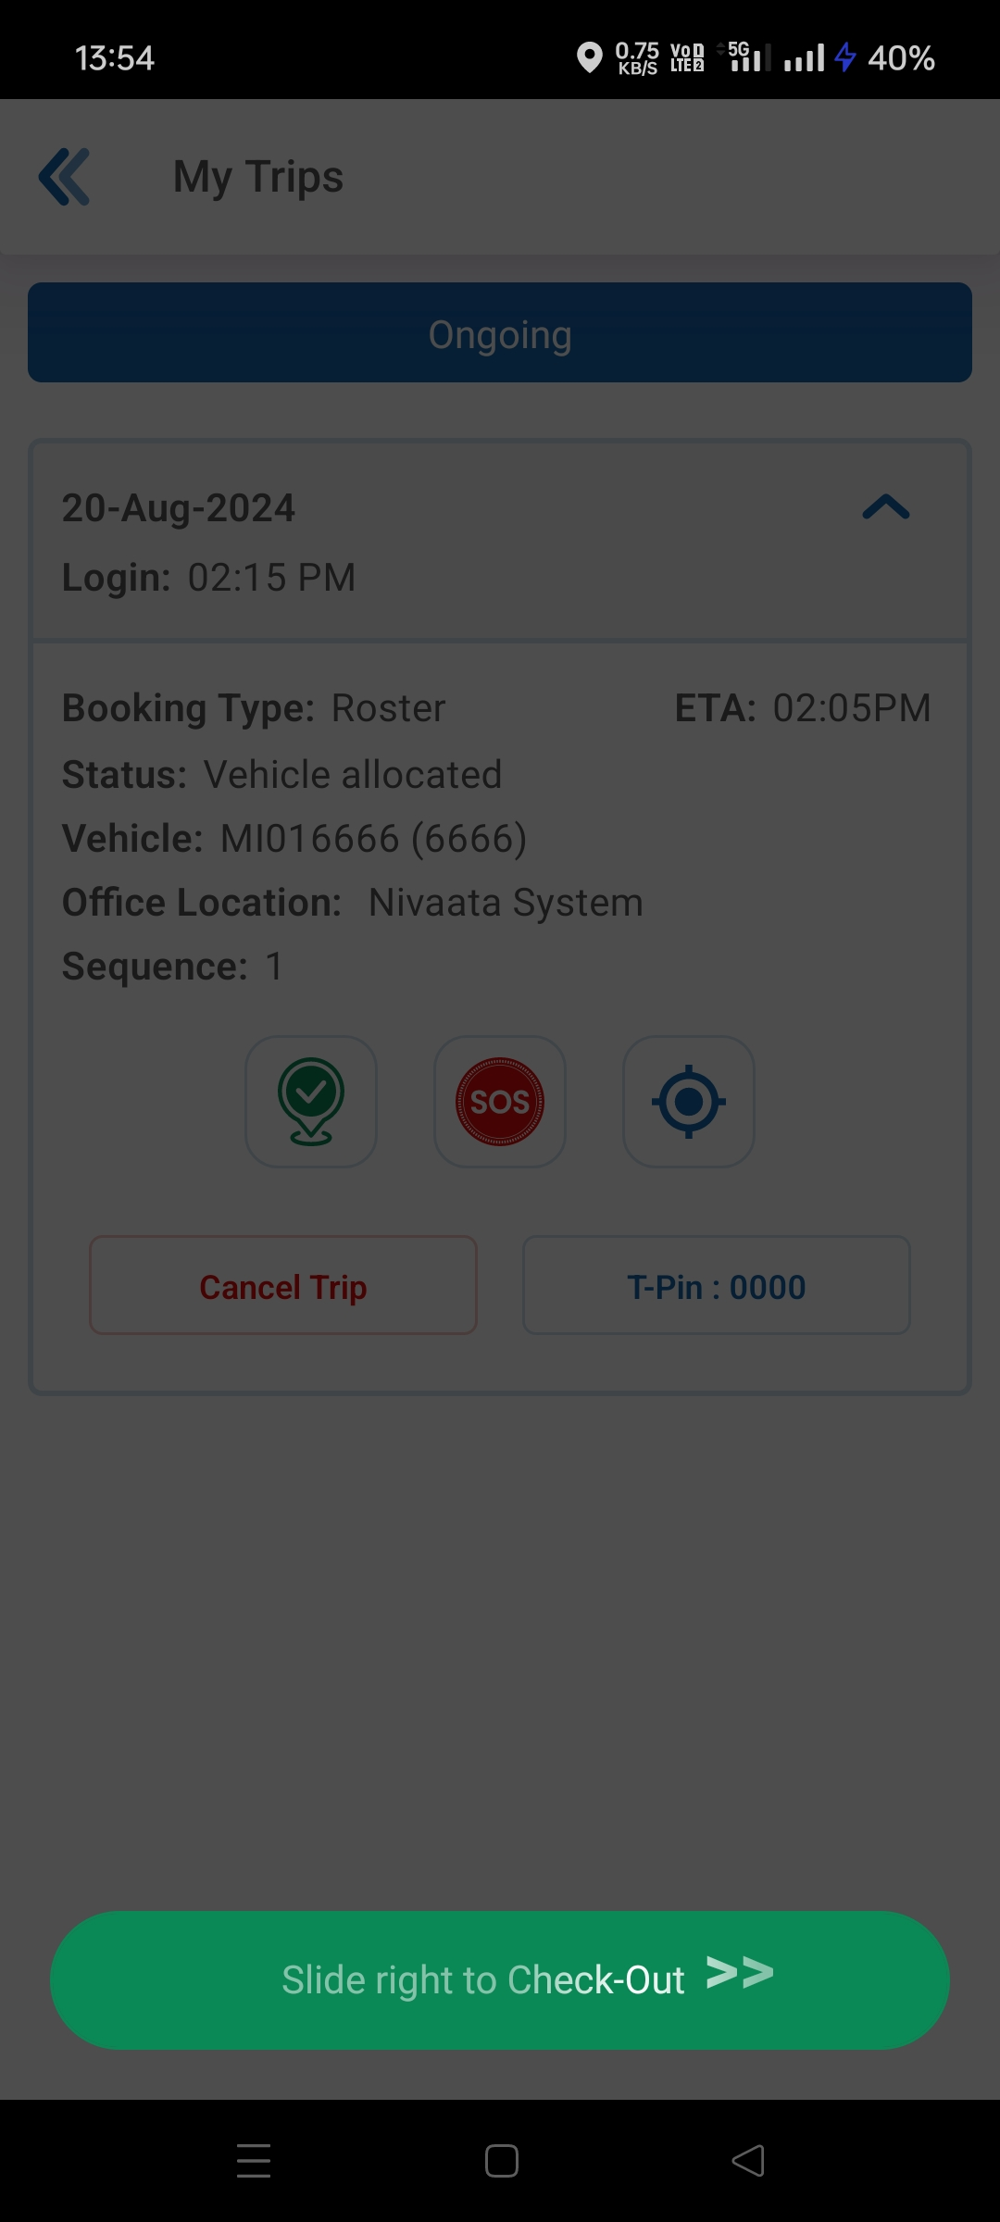
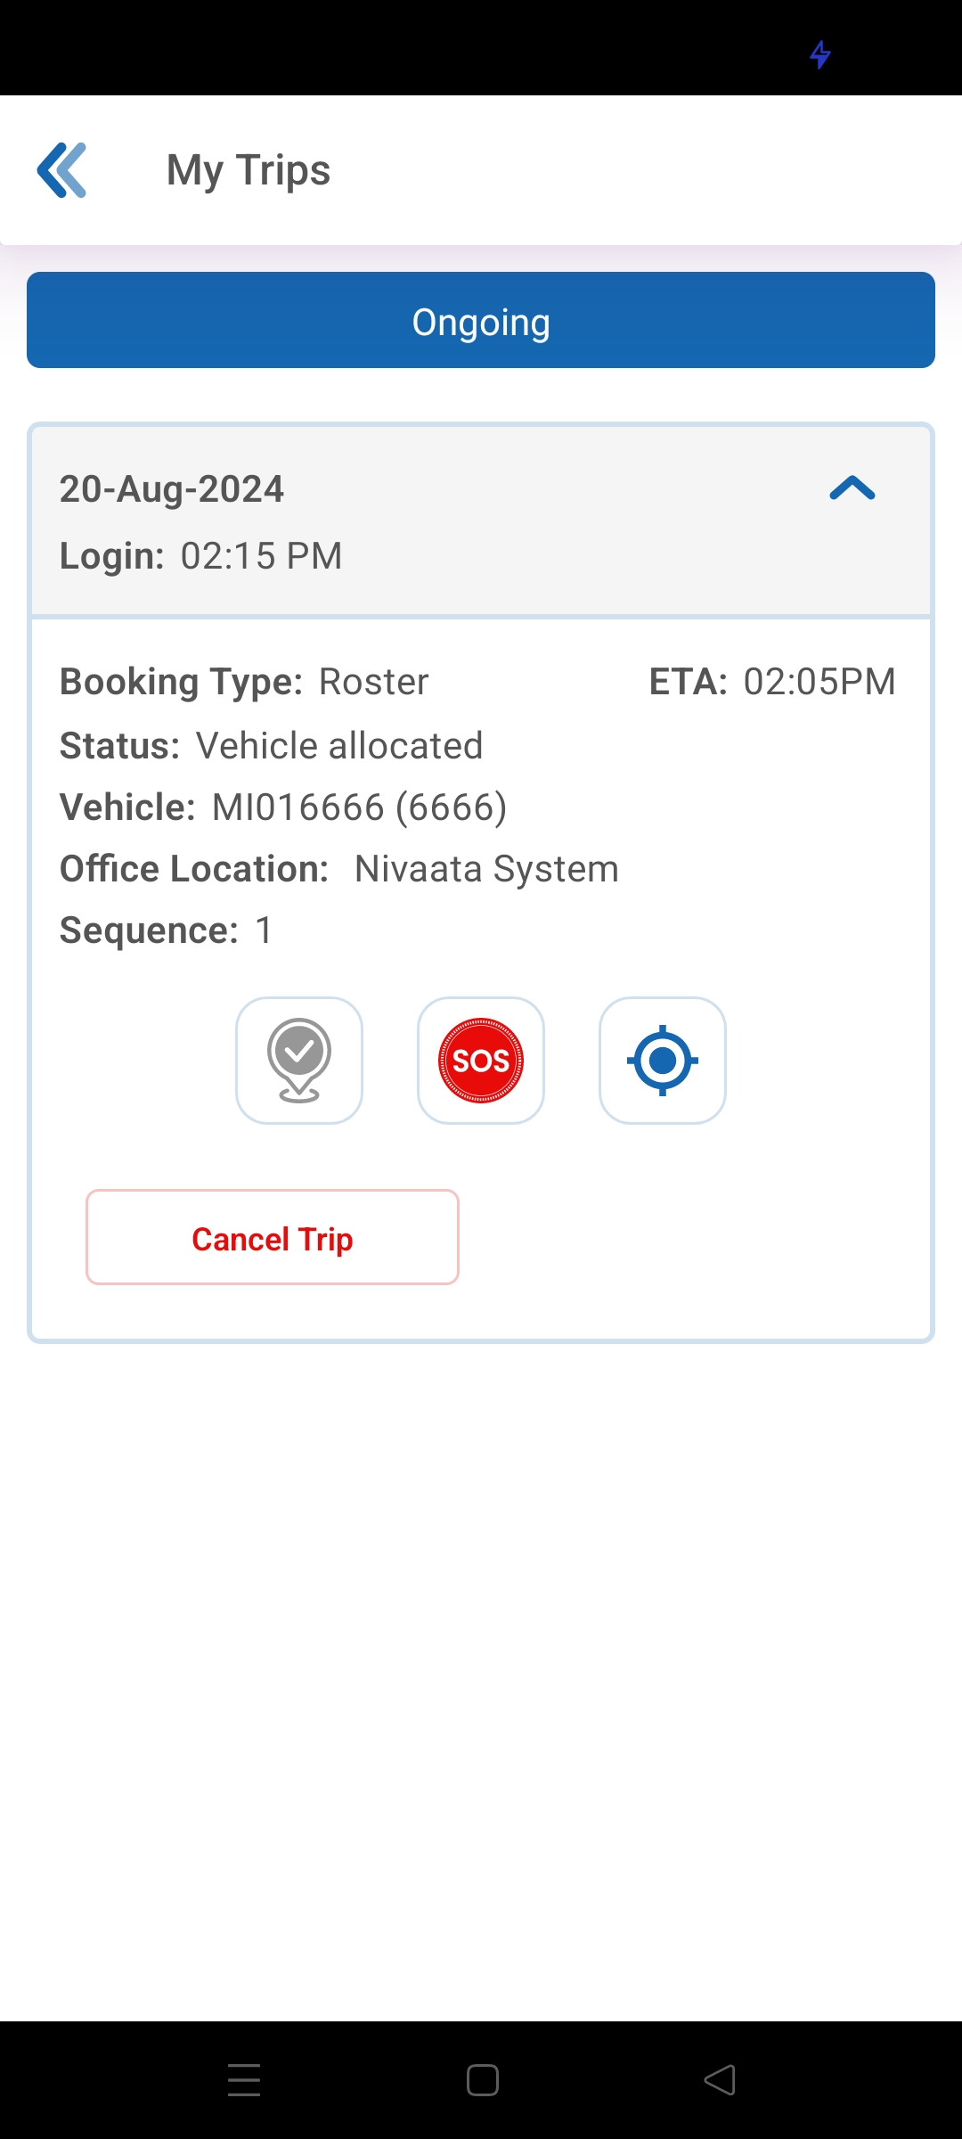
How Do I Mark My Check-in/Check-out Via Emp App
1
2
3
4
5
When in an active trip, click on the Check-in/Out icon and swipe right to check-in or check-out to let your transport team know that you have boarded or de-boarded safely It is important to check-in or check-out from your trips always.
This helps your Transport team with important information to plan better, save resources and provide you with a safe and comfortable travel experience

Slide 17
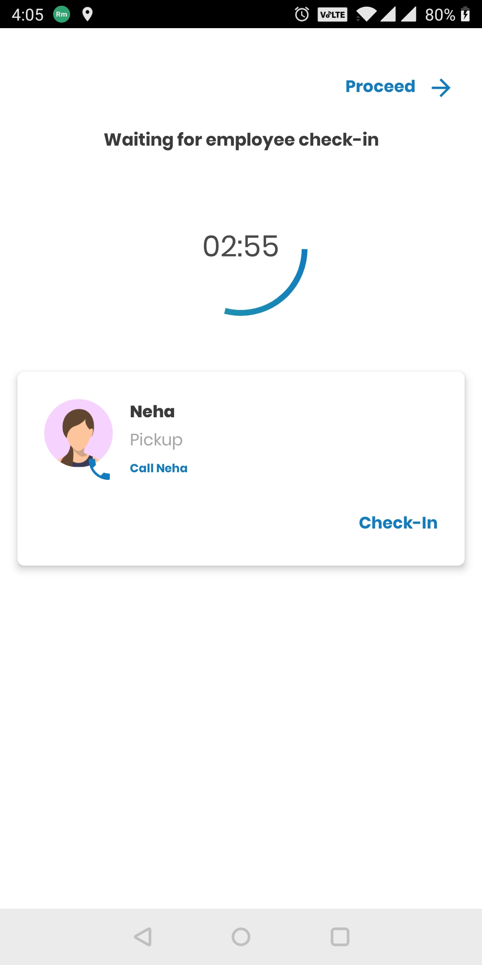
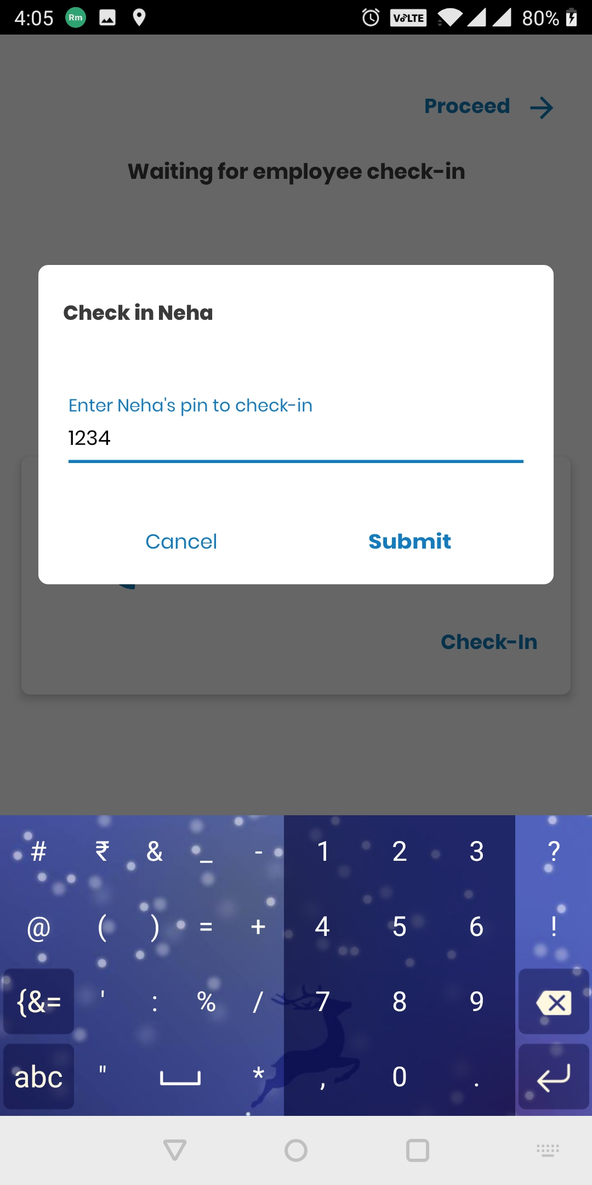
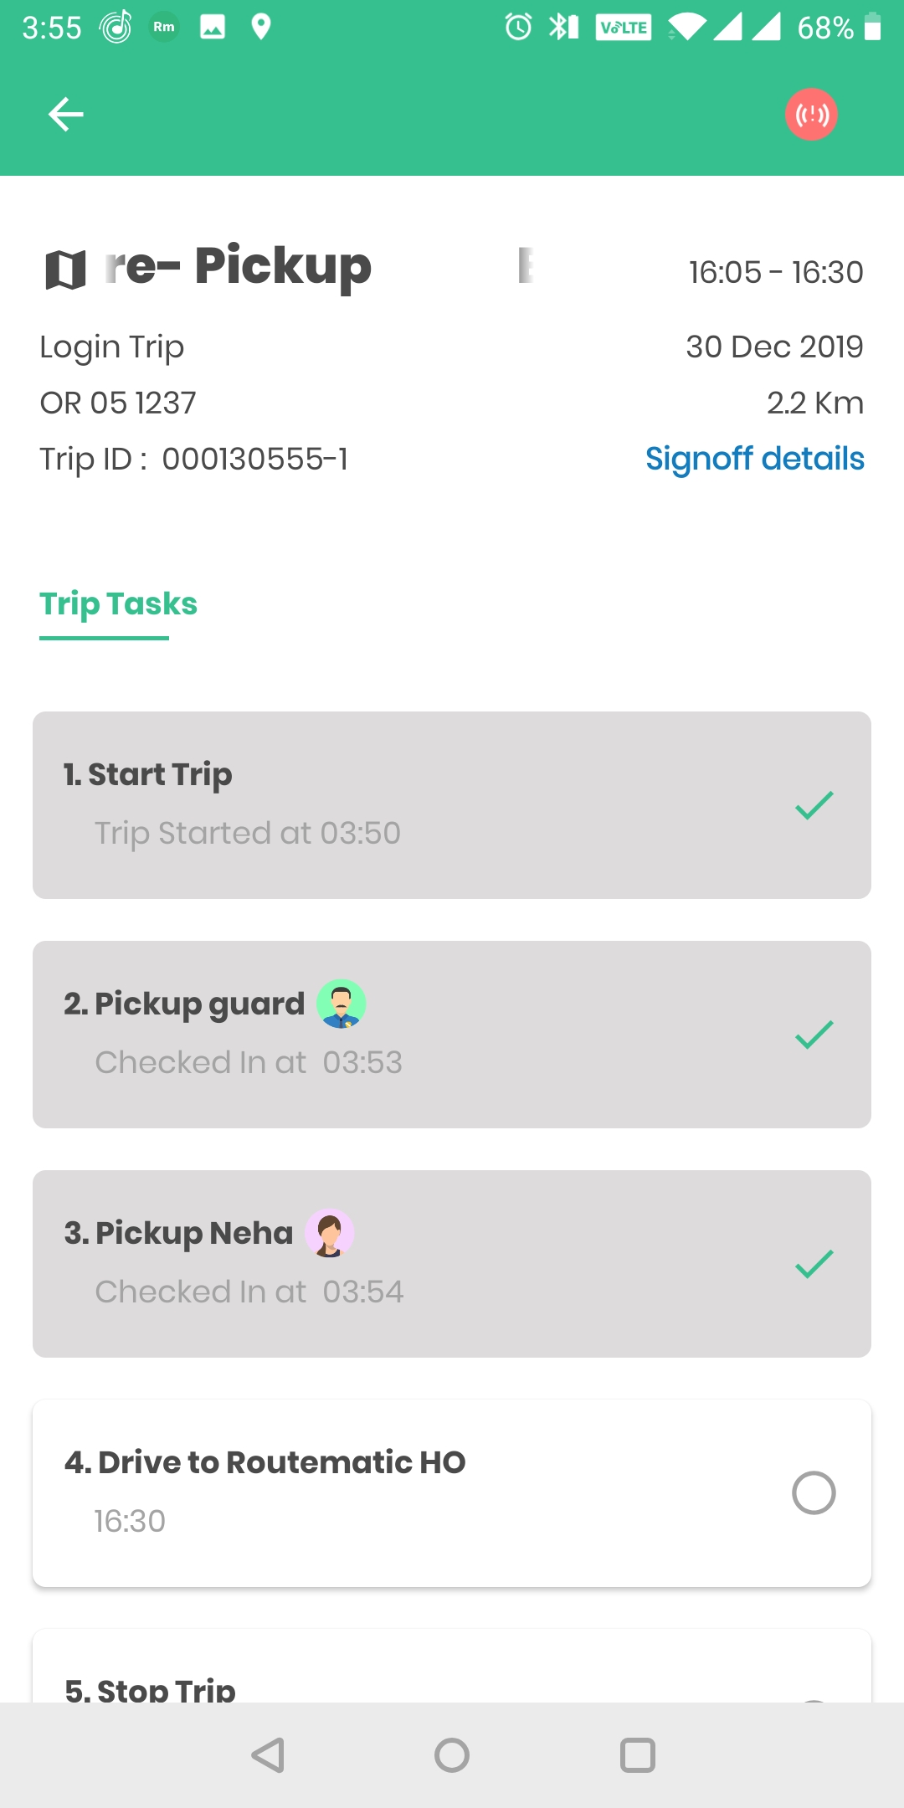
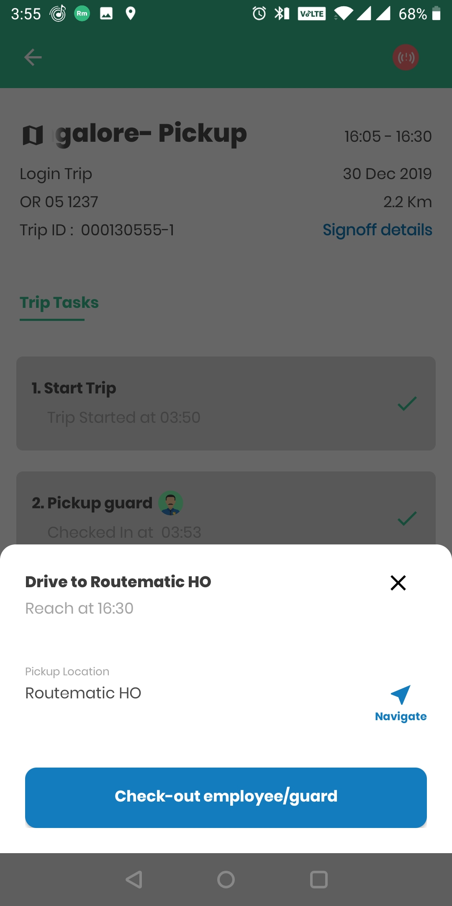
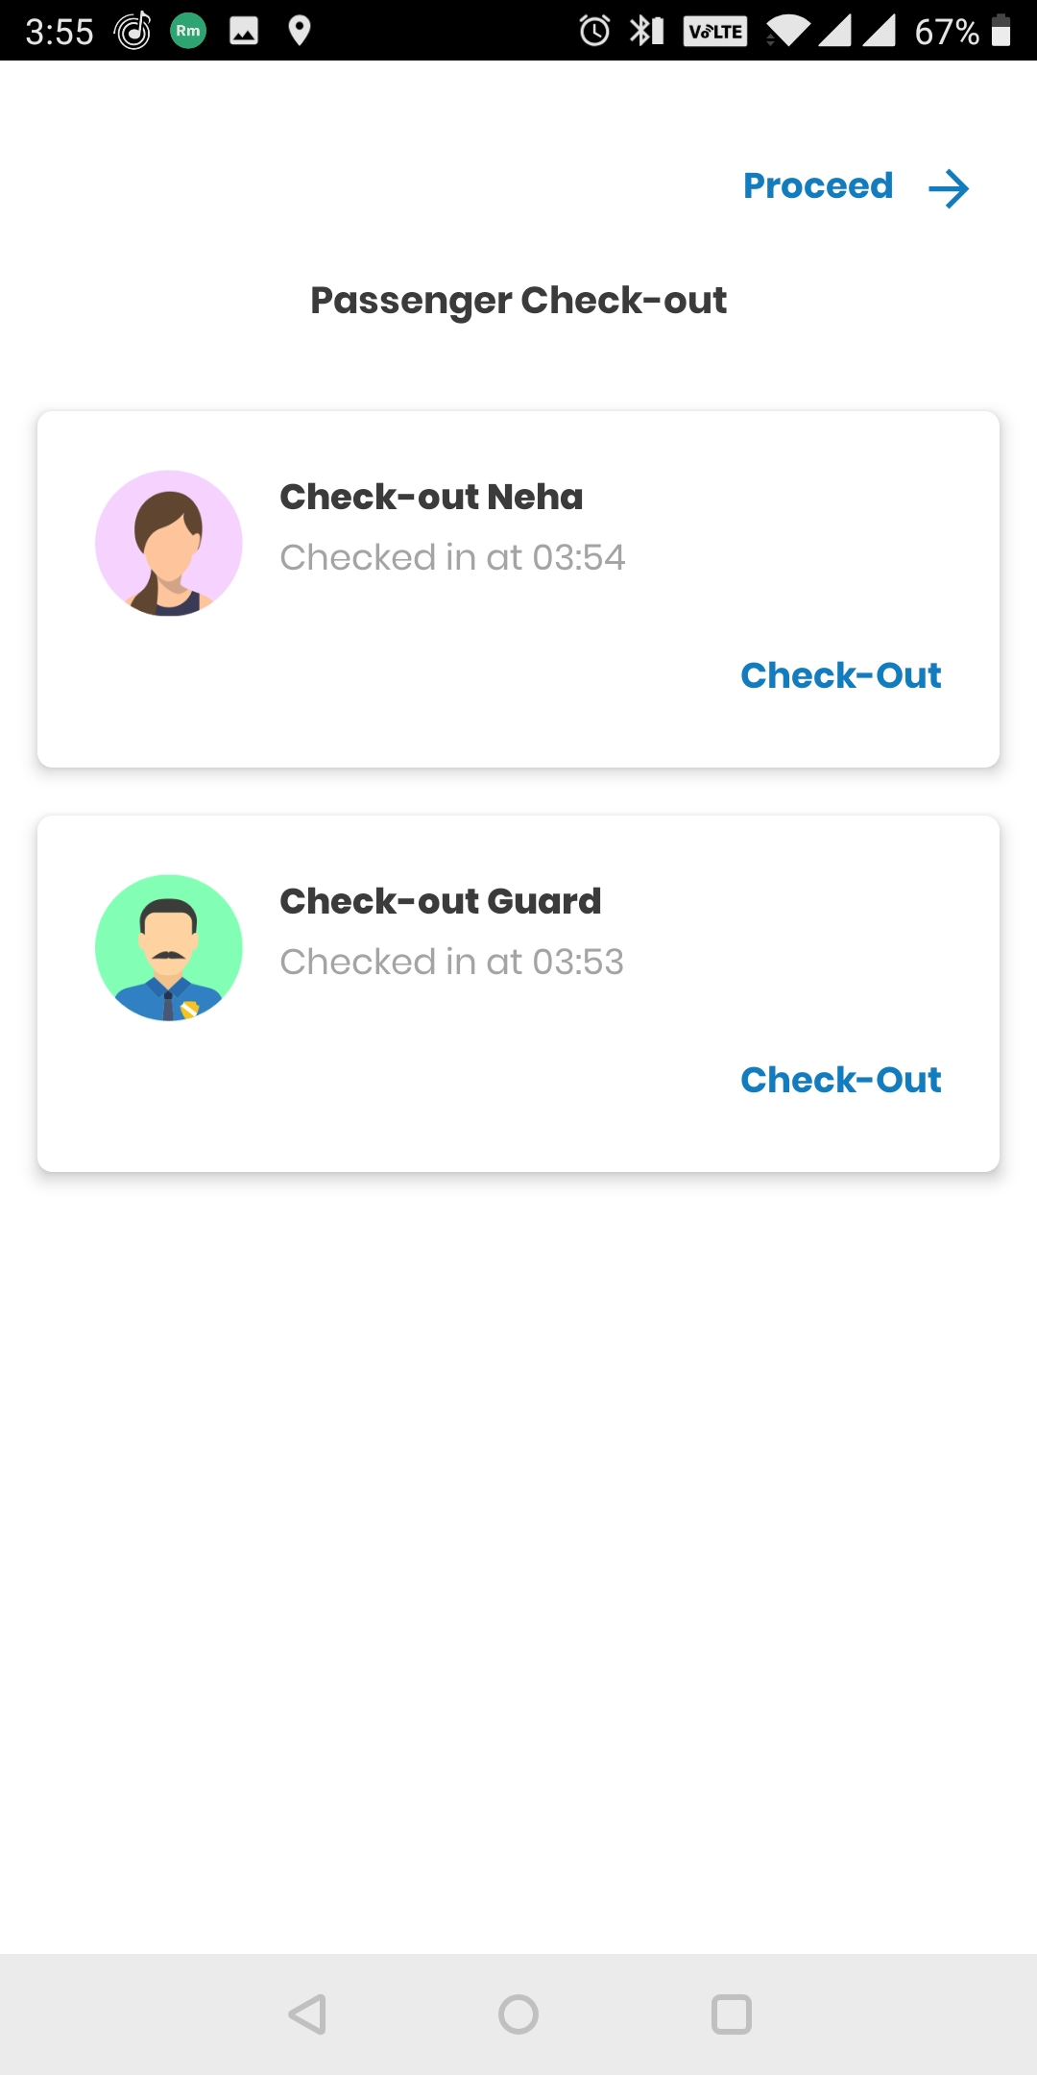
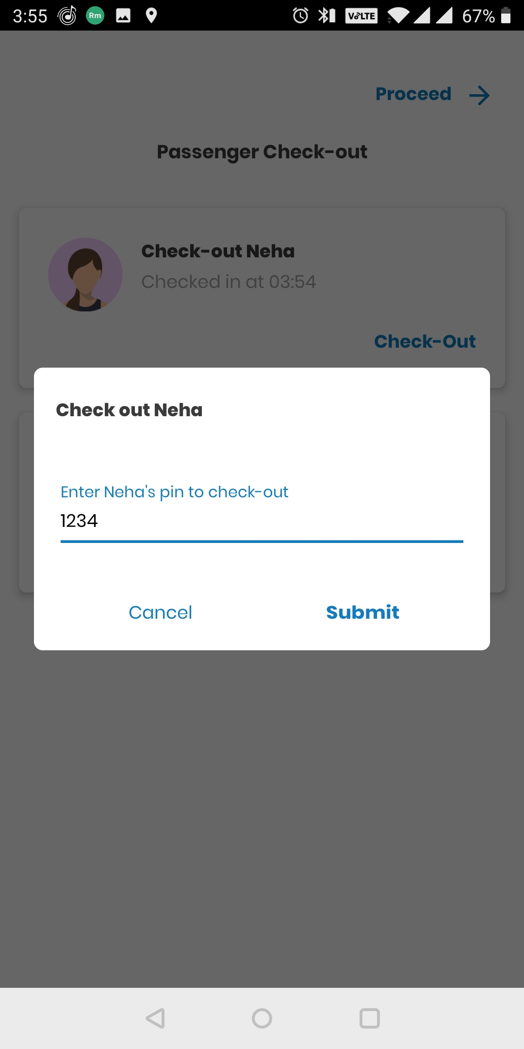
How Do I Mark My Check-in/Check-out Via TS App
On Location reach driver will click on the “Check-in” button
Once you board the cab, share the OTP received for the Trip to driver to mark your check-in
In Tripsheet app your status will change to ‘Checked-In’, same will also reflect in your mobile app My Trips and Track Vehicle screen.
Once the vehicle reaches office driver will click on the Check-out option
At the time of deboarding, share the OTP received for the Trip to driver to mark your check-out
In Tripsheet app your status will change to ‘Checked-out’, same will also reflect in your mobile app My Trips and Track Vehicle Screen.
For Login the Check-in/Check-out OTP would be same but for Logout it would be different.
It is important to check-in and check-out from your trips always.
This helps your Transport team with imp information to plan better, save resources & provide you with a safe & comfortable travel experience

Slide 18
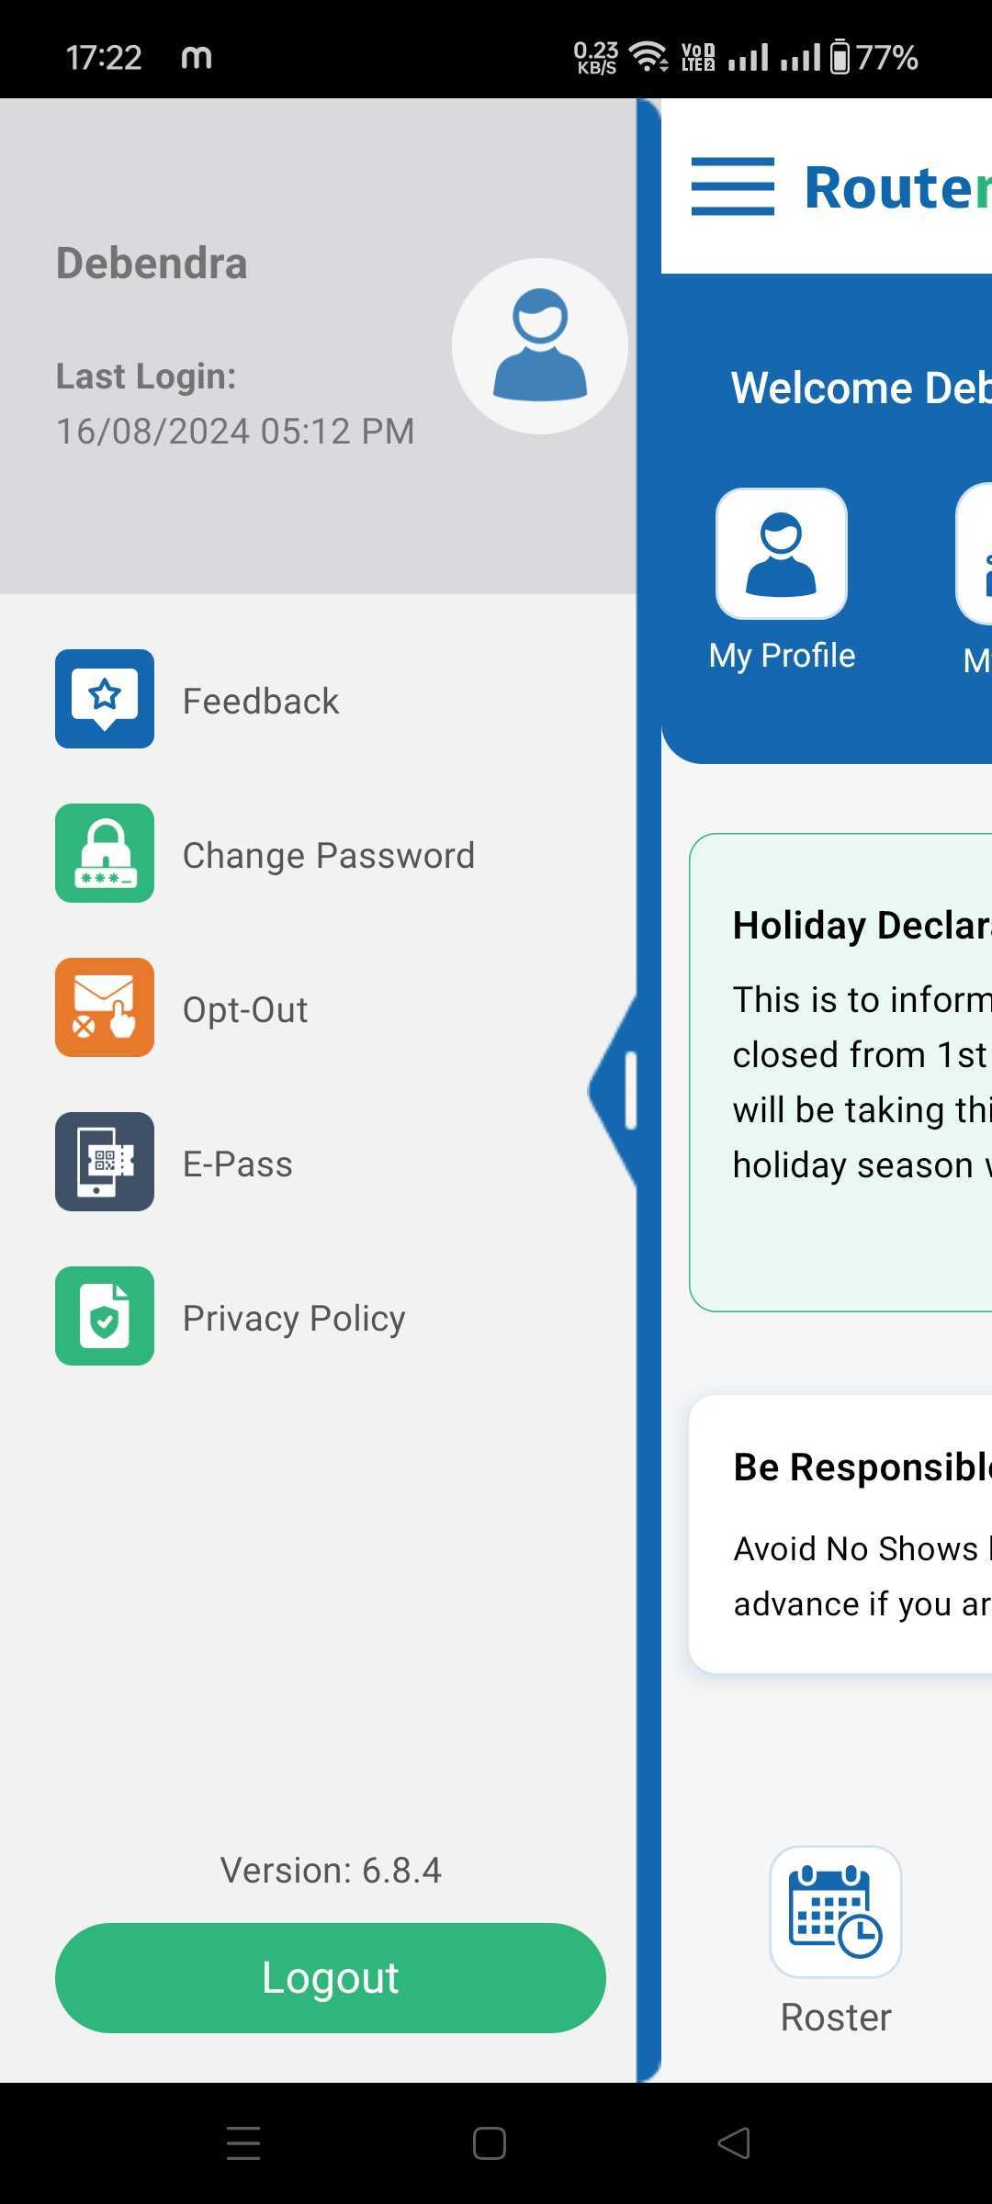
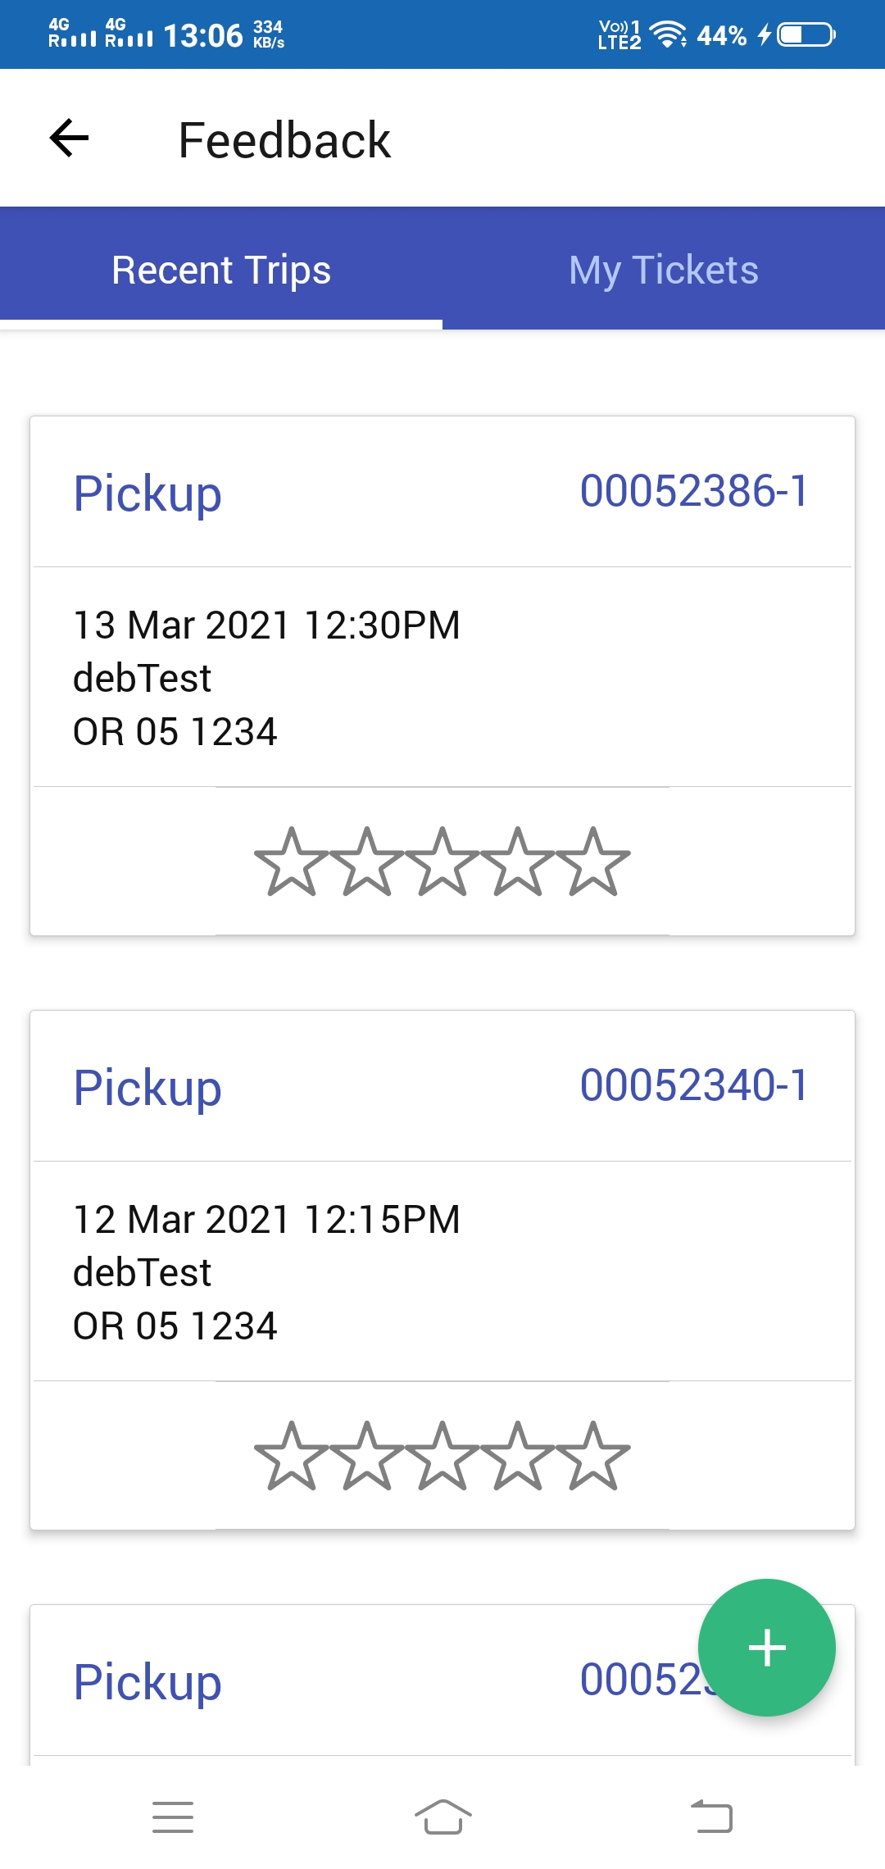
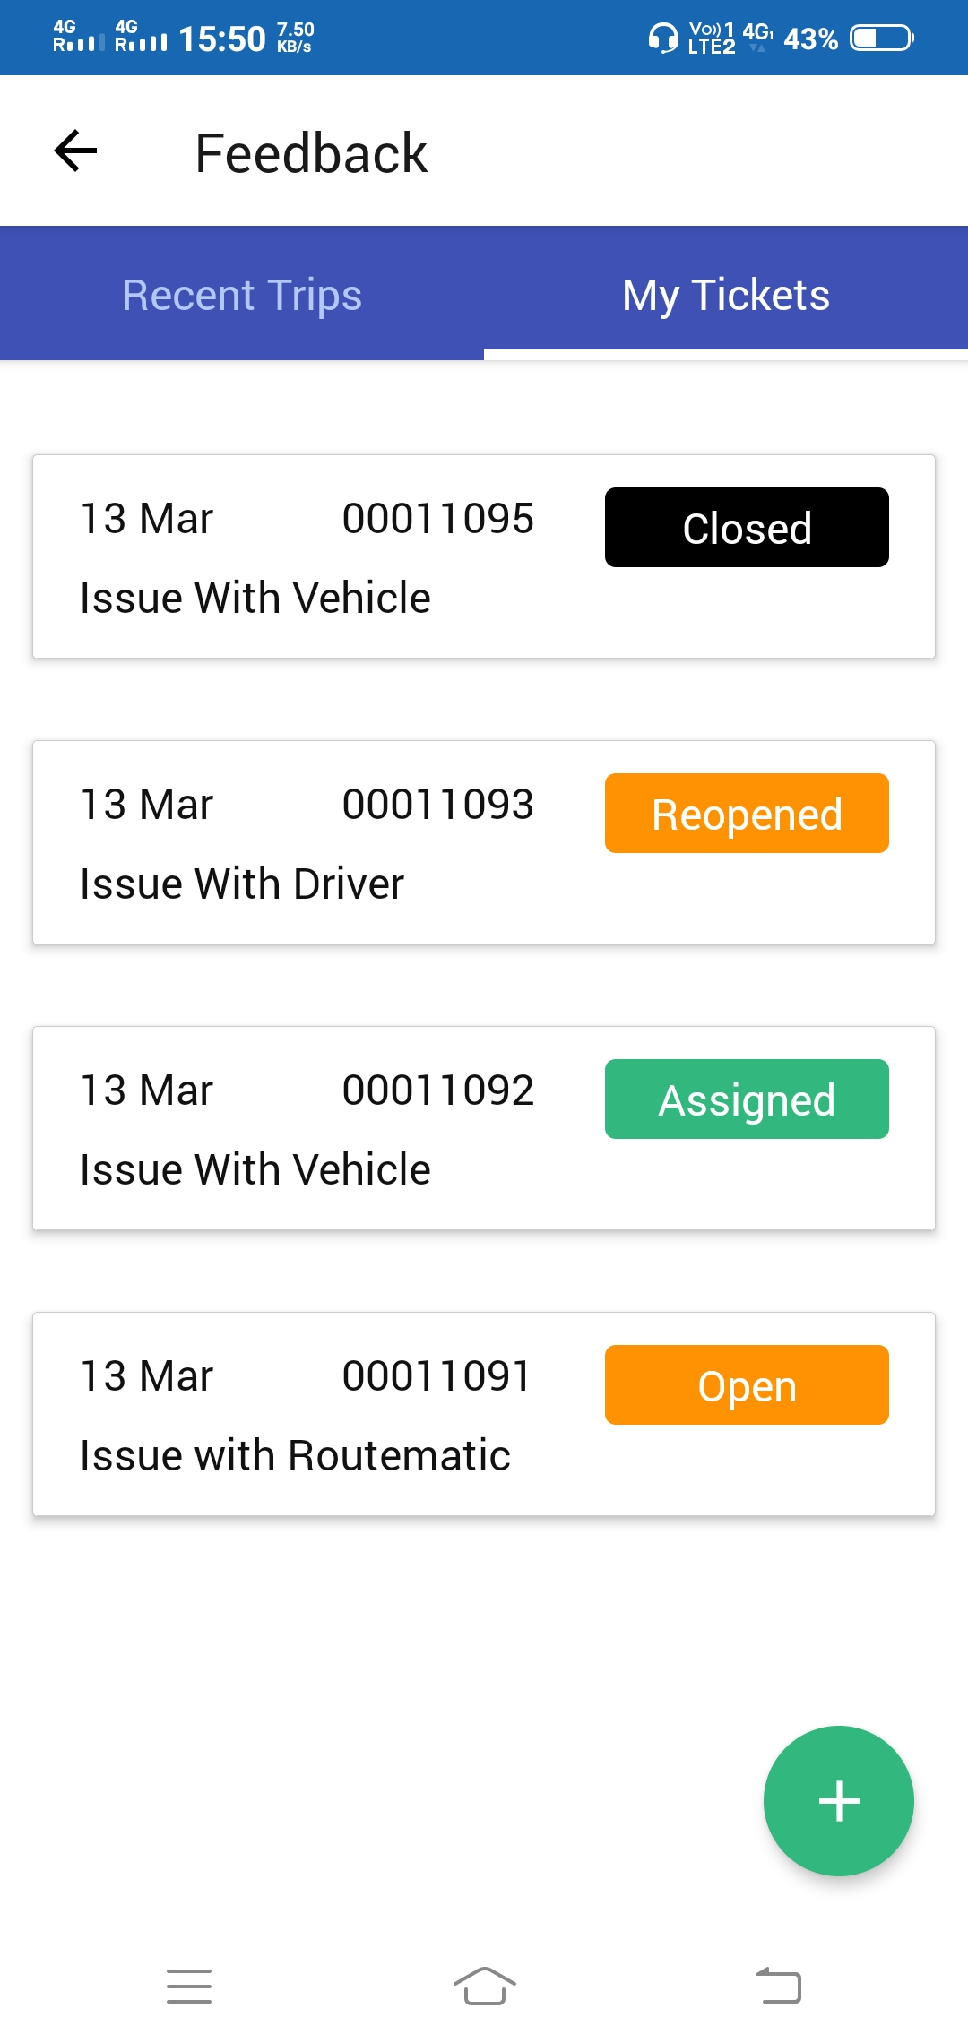
How Do I Give a Feedback
Enjoyed your trip? OR have Suggestions/Complaints?
Share your experience!
Give a quick Feedback about your trip to the Transport Admin using Feedback feature.

Slide 19
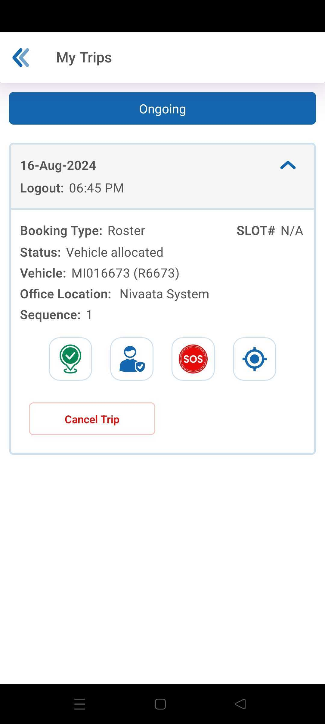
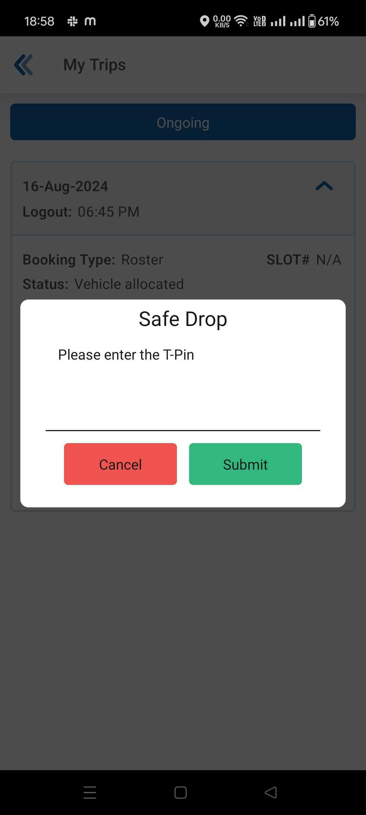
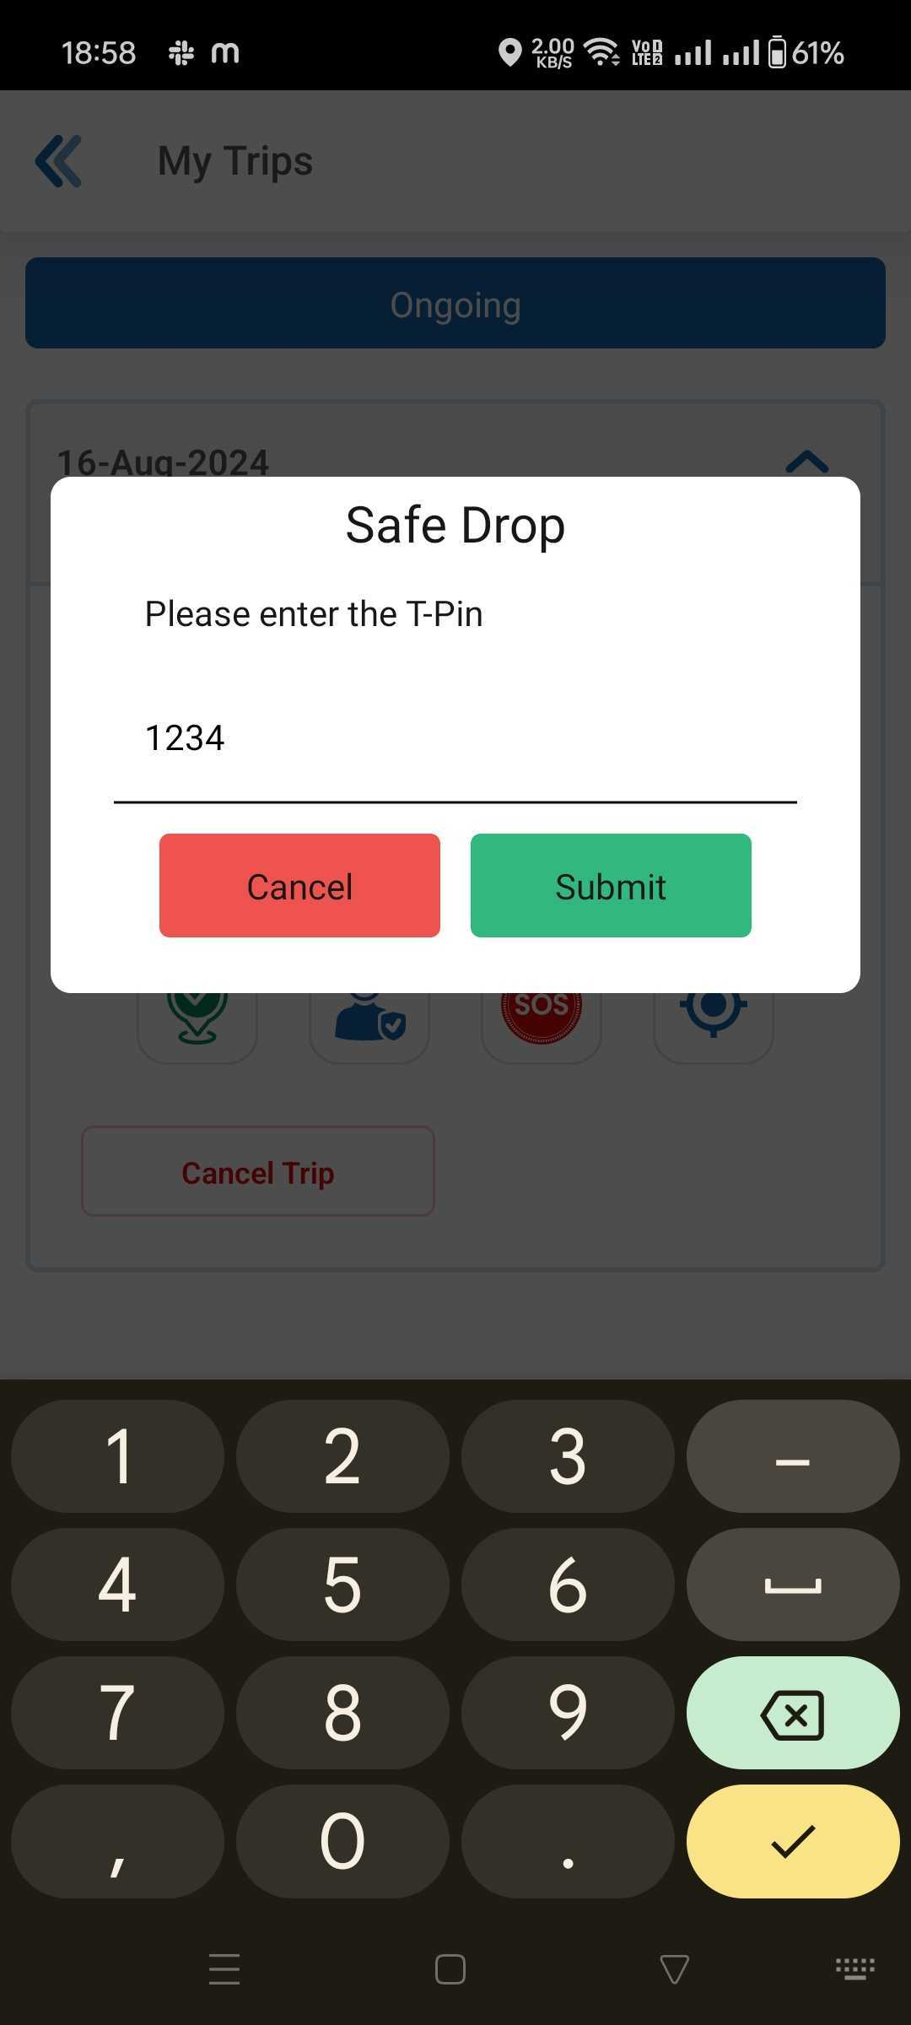
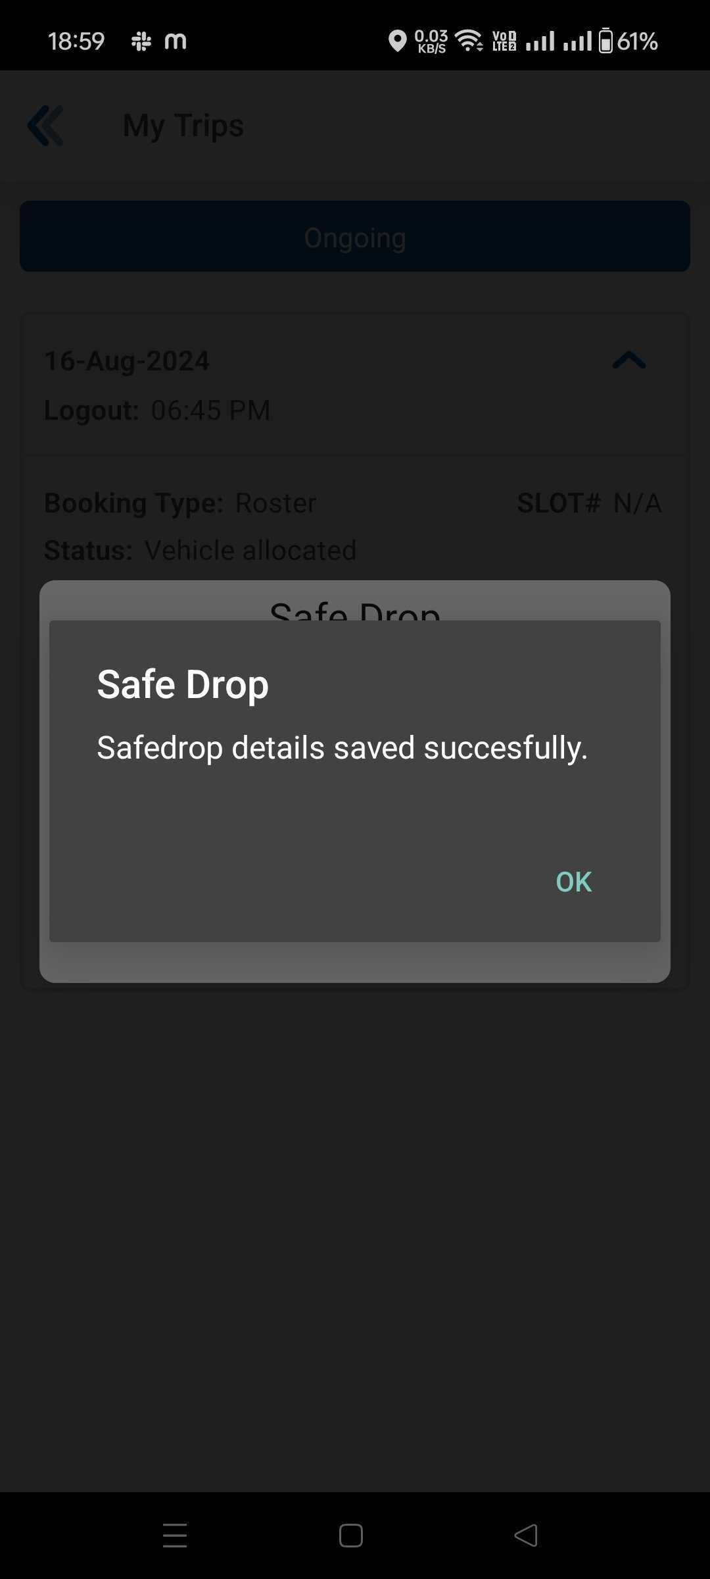
How To Mark My Safe Drop
Safe drop icon will only be available for Logout and once the Check-in is done it will get enabled!
Click on the Safe Drop Icon
Enter your T-Pin
Safe Drop Confirmation message

Slide 20
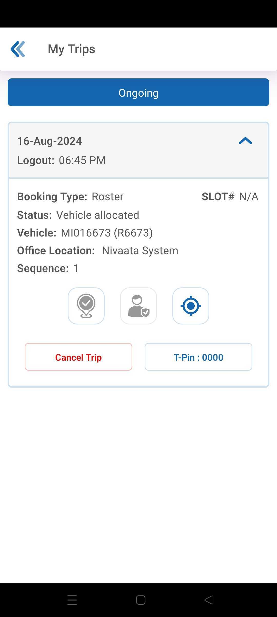


Safe Drop Icon Status
1
2
3
Safe Drop Icon, Employee not checked-in
Safe Drop Icon, when Check-in is done
Safe Drop Icon, when Safe Drop is Confirmed

Slide 21





Opt-out/Opt-in (1/2)
In case user doesn’t want transport for some time. He/she can opt-out of transport service temporarily.

Slide 22



Opt-out/Opt-in (2/2)
Once Opt-out placed, the button will change into Opt-in. User can update the request until scheduler run and profile become suspended.
User can cancel request any time.

Slide 23

SECTION III
ROUTEMATIC IVR

Slide 24

IVR Helpline
Helpline IVR No
PRESS 1
To Raise an Alarm
PRESS 2
Track your vehicle
PRESS 3
To talk to Admin
PRESS 4
To talk to Driver
PRESS 5
To Change
T-Pin
Initiates an IVR call to admin
Informs exact cab location
Connects you to the Admin
Connects you to Driver
Change
T-Pin

